Slide 1
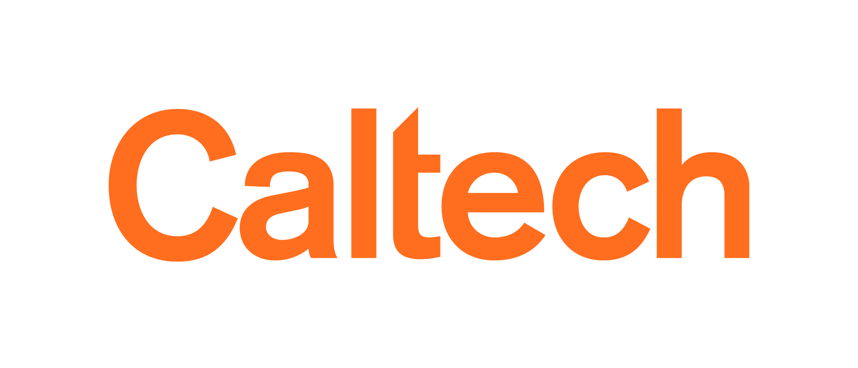
communicating science
Astrophysics
Relativity
Cosmology
Seminar
Nicholas Z. Rui
18 September 2023

Slide 2
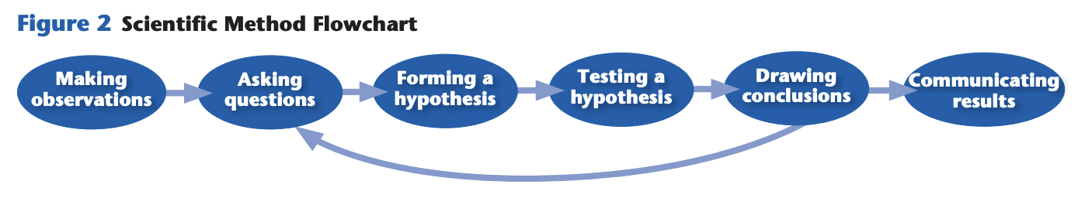
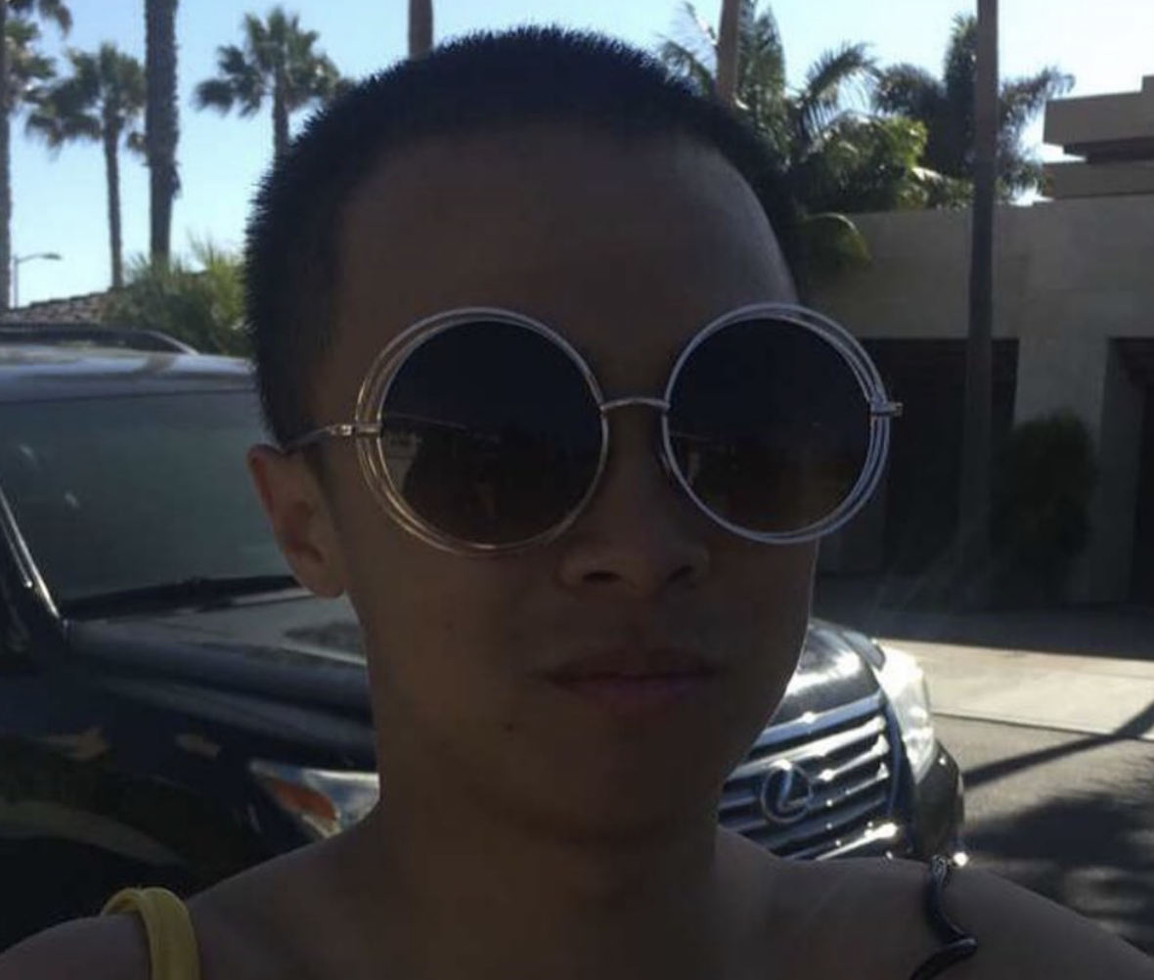
scope
we will be talking about communicating science effectively
https://bshs.smsd.us/staff_directory/mr__lockhart_s_site/earth_science/earth_science_textbook_chapter_p_d_fs
don’t take my word for it
I am a graduate student
in astrophysics
theory
Notes:
pretty open-ended presentation, because it’s not an objective thing, it’s an art
weird because science seems so objective, why is there any story-telling at all?
about me

Slide 3
always keep the purpose in mind
Notes:
- A presentation/paper/etc. is just an essay, and essays have thesis statements
- this is the number one priority over any preconceptions about how you think talks/papers/etc. should look
- subjective thing: you can do literally whatever you want, but please do it on purpose

Slide 4

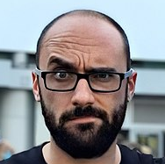
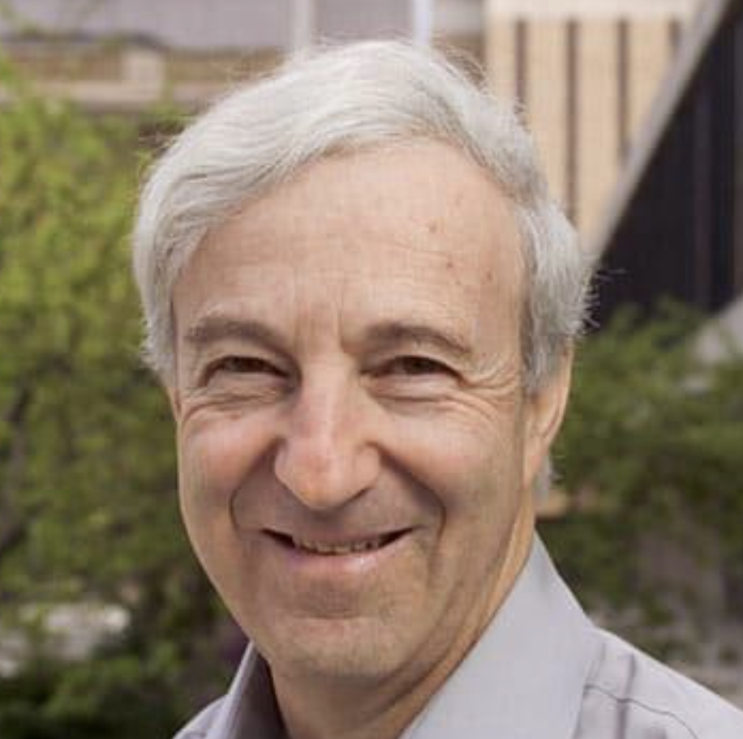
writing with purpose
would you give all these people the same presentation?
what is their background?
what do they care about?
what do you want to happen?
Notes:
ask people what they might do differently for these different kinds of presentations?
is it a conference, group meeting, public talk?
background:
- informs jargon that can be used
- informs concepts that can be invoked
--- to physicists: can explain stuff via harmonic oscillator
--- you may have to overturn existing intuition (e.g., relativity vs. newtonian, different stellar mass ranges)
care about:
- researchers mostly care about their own research
- what you find interesting may not be what others do
--- e.g., you may care about a cool algorithm or cool math (or cool experimental setup), but most people just want your result and use it blindly
--- e.g., BBH simulations vs. LIGO predictions/FRBs, cool asteroseismology math vs. inference of stellar parameters
- can convince people to care about something else:
--- hard
--- should be done deliberately
--- can leverage what they already care about
want to happen:
- want to start a collab?
- want to be accepted into grad school? get a job?
- getting (the public?) excited about science?
- being informative? e.g., this ARC seminar is not very directly good for my career, but snacks are nice

Slide 5
writing with security
honesty ≠ self-deprecation
make concrete, “falsifiable” claims
don’t overassume background
don’t try to “blend in”
be concise
Notes:
ask: what do people think I mean by this?
these are just general principles
self-deprecation:
- caveats are good science: science IS messy
--- however, non-specific statements about your own competence are NOT good caveats
--- “I’m just a grad student,” “there are a lot of things I don’t understand about this” are not “honesty”
--- it may feel like this is “valid context,” but if you think critically about this it makes zero sense to say these things
- “fake it till you make it”
concrete claims: -- comes from talk by Simon Peyton-Jones (Microsoft)
- don’t be vague: ”We demonstrate that sufficiently strong magnetic fields will suppress gravity wave propagation.”… not “We study stellar oscillations in magnetized stars.” – it is IMPOSSIBLE to fail at the latter
- “We develop a robust eccentricity reduction algorithm which can do X, Y, Z”… not “we study the problem of eccentricity reduction”
- makes sense, but seems counterintuitive since you’re holding yourself accountable
- failure to do this comes from insecurity: if you’re writing/publishing/etc., you should at least act like you believe in your conclusions
don’t overassume background
- if you spent even a normal amount of time thinking about your problem, you now know about it more than even most other experts
- affects also whether they even understand why it’s important in the first place
- dirty secret: on apps and job talks and stuff, except for the basics, people aren’t objective arbiters of what is “good work” and “exciting,” even if they have strong opinions
- if a friend tells you they don’t understand your app, don’t assume that a faculty who reads it will
- in a talk: in a short talk, you can’t do much more than convey basic results, intuition. theory talks are hard, can’t expect any real understanding of any more than 1-2 eqns tbh
blending in:
- it’s ok to mimic behavior you find compelling/clear if you can identify explicitly what’s good about it
- don’t necessarily do things everyone else does just because they’re doing it
- most people don’t say in academia, so it makes no sense to just copy them
- blending in doesn’t work because stand-outs are easiest to choose
- when you do this, you are banking on the fact that stem specialists are just all really good at communicating, which is a terrible bet
concision:
- be concise
- …
- easy when starting out to try to “pad” out the length of a paper or a presentation because you don’t believe you’ll have enough material
- you can do this if you want, but you will end up having to cut a lot, and you will do this enough times that you’ll learn it’s just a waste of time and counterproductive

Slide 6
writing papers
Notes:
- papers: they are THE deliverable
at our age, writing one is a milestone and feels like a big achievement – this makes it feel like the paper is “about us”
however, remember that papers are how we communicate results people care about, not how we vent about the trials how we had to go through (nobody cares about YOU)

Slide 7
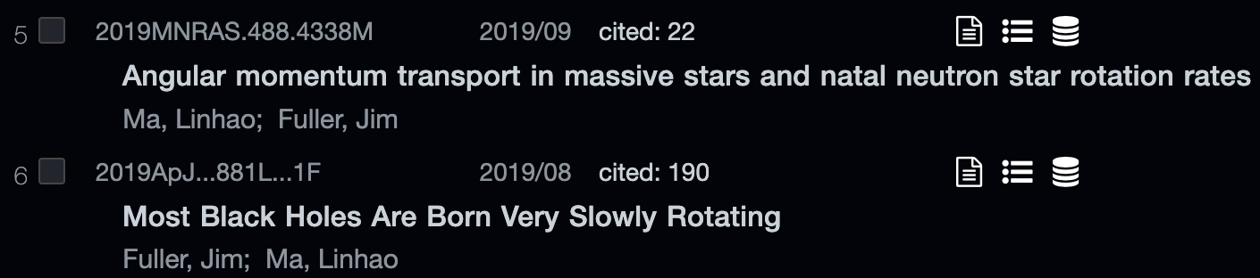
title & abstract
what would you title this paper?
Topic: A modified version of the magnetic Tayler instability can redistribute angular momentum fast enough to explain the slowly rotating cores of many stars. This may have implications for compact object mergers.
Notes:
compare and contrast these titles
for titles: this is where you can lose people; this is where they decide whether your thing is even worth reading

Slide 8
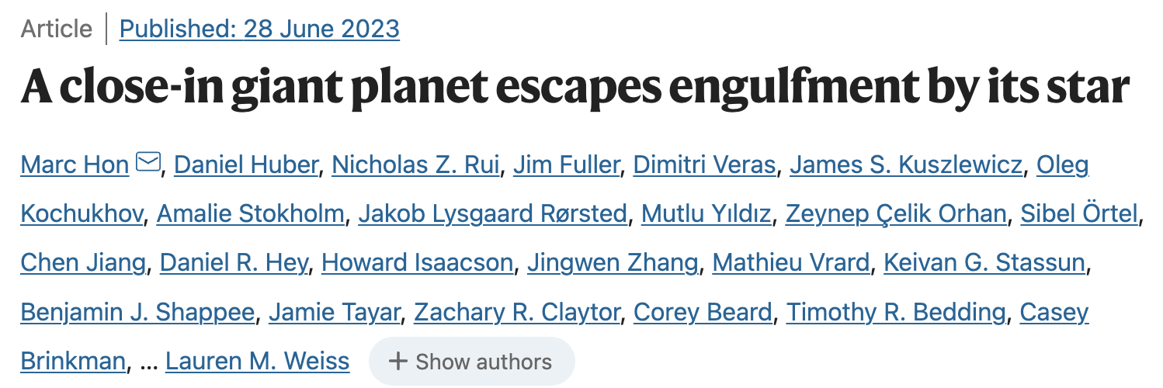
title & abstract
what would you title this paper?
Topic: Previous authors discovered a Jupiter-mass planet around a red giant. Follow-up asteroseismic observations reveal that the star is helium-burning. Because of its low mass, it should have expanded ~200 solar radii at the helium flash and engulfed its planet.
Notes:
words we don’t have:
- asteroseismology
- red giant
- red clump
- helium-burning
- helium flash
- radial velocity method

Slide 9
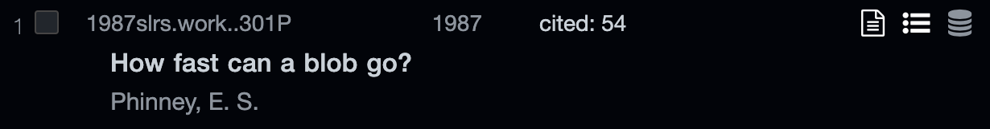
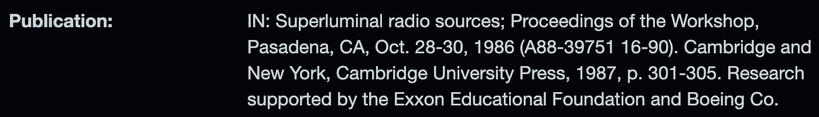
title & abstract
what would you title this paper?
Topic: Knots of gas coming from quasar jets experience Compton drag which prevents them from going faster than 20c. Very-long-baseline observations reveal that such knots can travel with apparent transverse speeds ~10 c, which is consistent with this picture.
Notes:
words omitted:
- quasar
- superluminal
- Compton drag
- VLBI, radio, etc.
- transverse speeds

Slide 10
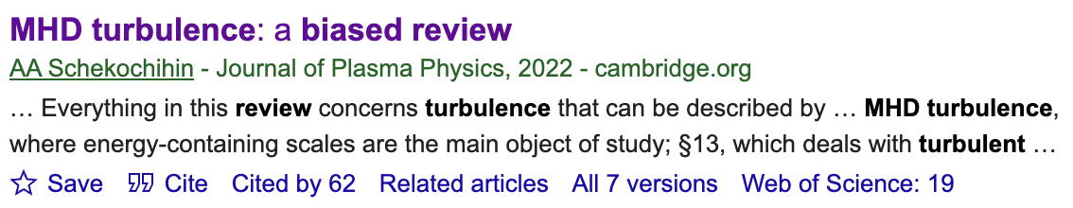
title & abstract
what would you title this paper?
Topic: A pedagogical review of magnetohydrodynamic turbulence, put in the context of current debates about the alignment theory.
Notes:
playful

Slide 11
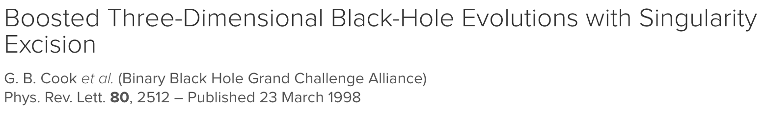
title & abstract
what would you title this paper?
Topic: We present a method to perform singularity excision in numerical relativistic simulations of binary black holes, without fixing the coordinates of the singularities.
Notes:
somewhat technical

Slide 12
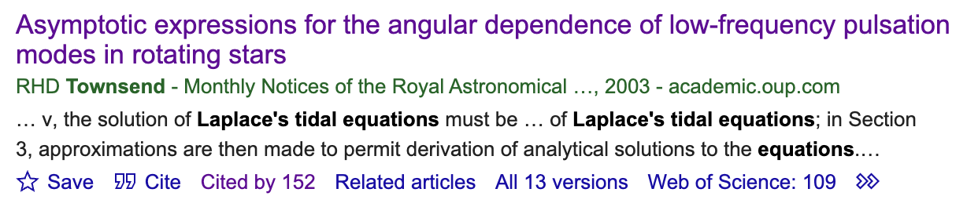
title & abstract
what would you title this paper?
Topic: The Laplace tidal equation describes the oscillation modes of a rotating star under the traditional approximation. We analytically derive the behavior of the eigenvalues of this equation at high spin parameter.
Notes:
quite technical, but well-cited because it’s useful to people (but unread by others)
omits:
- Laplace tidal equation
- traditional approximation
- Coriolis force

Slide 13
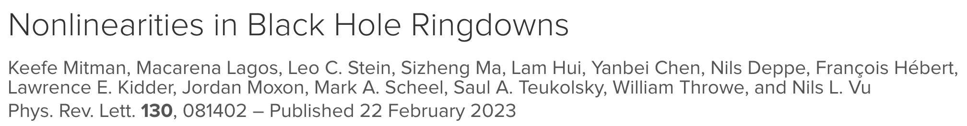
title & abstract
abstract: a short summary which “sells” your work to the desired audience
introduces problem statement and/or background
summarizes results concisely and concretely
gives big picture impact: make people want to read this
The gravitational wave strain emitted by a perturbed black hole (BH) ringing down is typically modeled analytically using first-order BH perturbation theory. In this Letter, we show that second-order effects are necessary for modeling ringdowns from BH merger simulations. Focusing on the strain’s (ℓ,m)=(4,4) angular harmonic, we show the presence of a quadratic effect across a range of binary BH mass ratios that agrees with theoretical expectations. We find that the quadratic (4,4) mode’s amplitude exhibits quadratic scaling with the fundamental (2,2) mode—its parent mode. The nonlinear mode’s amplitude is comparable to or even larger than that of the linear (4,4) mode. Therefore, correctly modeling the ringdown of higher harmonics—improving mode mismatches by up to 2 orders of magnitude—requires the inclusion of nonlinear effects.
Notes:
abstract: like title, advertises your work to people who you want to care about it
problem statement: brief, intuitive description of your problem statement.
– use of jargon is ok if you’re ok with restricting the audience scope, but make sure the jargon is really obvious to that audience
say CONCRETELY what you’ve done, succinctly.
- again, make it “falsifiable” – don’t be vague
- make it as easy to understand as possible: ugly details that are not central to the story are what the paper is for
- numbers and details are fine if they make your work look attractive
big picture impact
- this is very important
- do not assume your reader will understand the relevance of your results, even if they work in your field
- even if they should, making it explicit is one-less step they have to do, and also prevents them from second-guessing their understanding of the impact
abstracts: typically written last, because the project is very likely to evolve over time, and also during writing different “take-aways” may become obvious

Slide 14
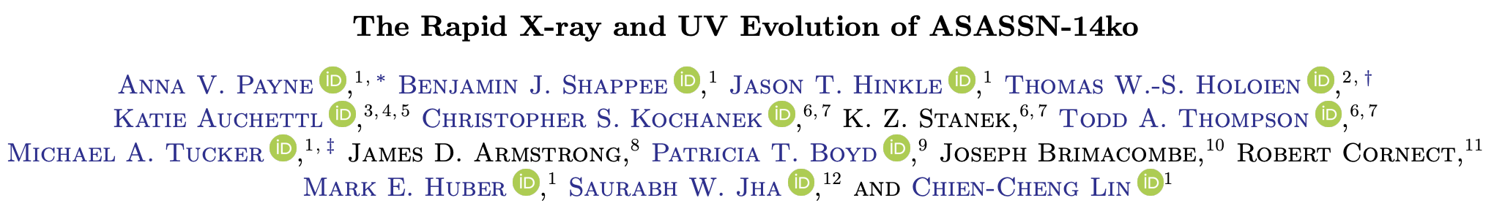
anatomy
introduction: introduce whatever relevant background, signpost your results
methods: technical details
results & discussion: present results, but contextualize in the context of things people actually care about
conclusion: future work
“Active galactic nuclei (AGN) normally vary stochastically across the electromagnetic spectrum, and the variability can be reasonably well-modeled as a damped random walk…”
“In this paper, we present analysis of the subsequent flare, which occurred as predicted in September 2020.”
“This ∼20 day timescale over which the flares’ blackbody luminosity decays is much shorter than for all previously studied TDEs.”
“Future flares will continue to be important to determine which characteristics change and what remain the same, especially in the high energy regime.”
Notes:
broad anatomy of a paper: HOWEVER, this standard structure is just instrumental to your purpose
introduction: people have differing opinions about what this is for; you can proceed with a tiny review (helpful for beginners) or just go super directly to the topic. former is pedagogically more useful, but latter is going to be clearer about your contribution probably.
- say your results explicitly somewhere, good to signpost (give outline) of the rest of the paper, to say what the different sections are (in some logical order)
- try to attach your work to something people care about; maybe this means starting from a big problem and zooming in
methods: just say what you did, I guess
results & discussion: say what the results are, but try to contextualize it in the context of stuff people care about
- this is ofc audience specific
- do you have some observable prediction?
- does your discovery imply progress on any question?
conclusion:
- I do a bad thing which is just summarize things again; some of this is good imo (I like to even bullet the conclusion so that a list exists of what I’m claiming)
- future work is good

Slide 15
making figures
Notes:
most experts go right to this after reading the abstract, so make them clear and intentional

Slide 16
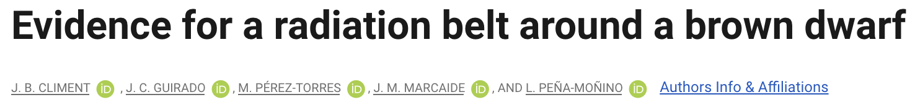
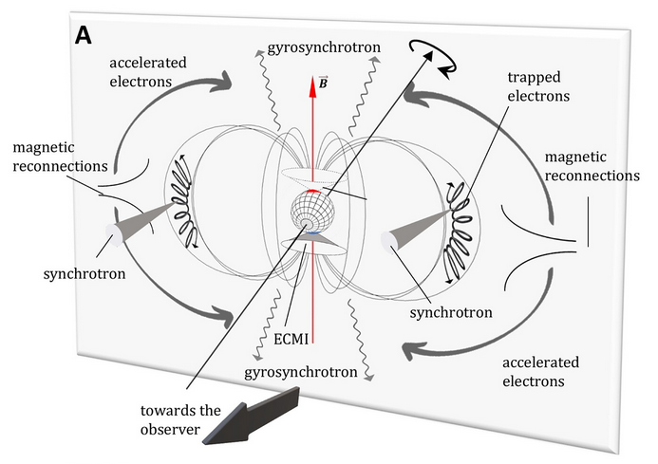
figures
Notes:
- learn inkscape or something

Slide 17
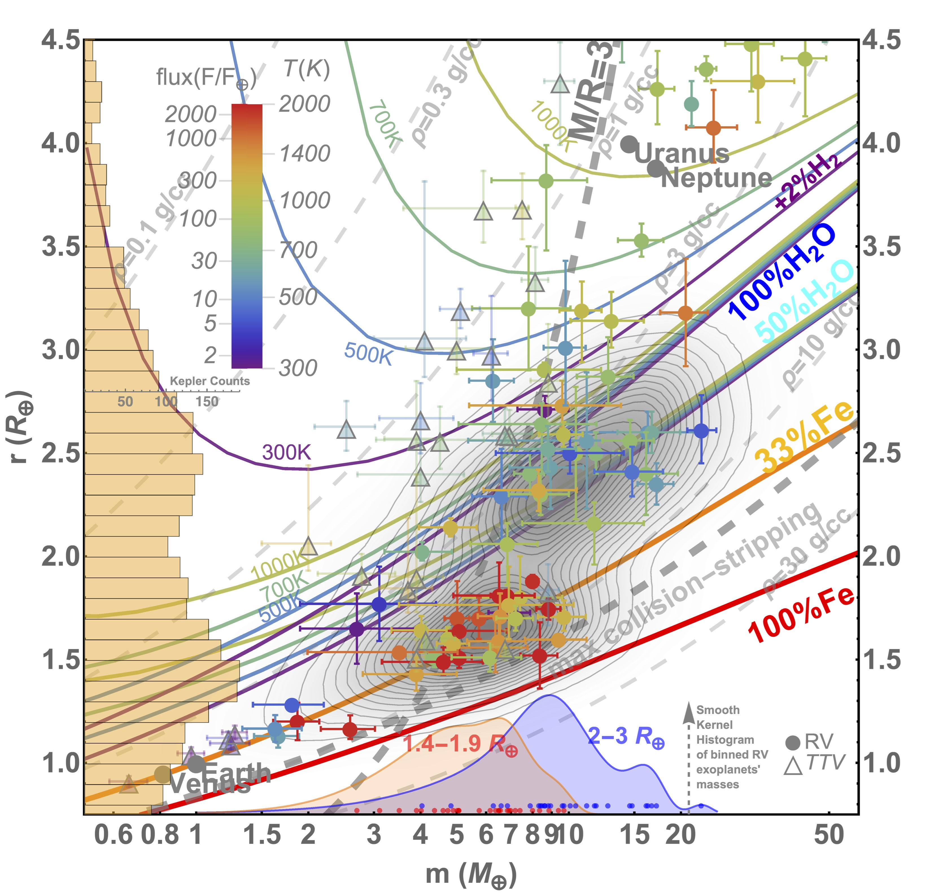
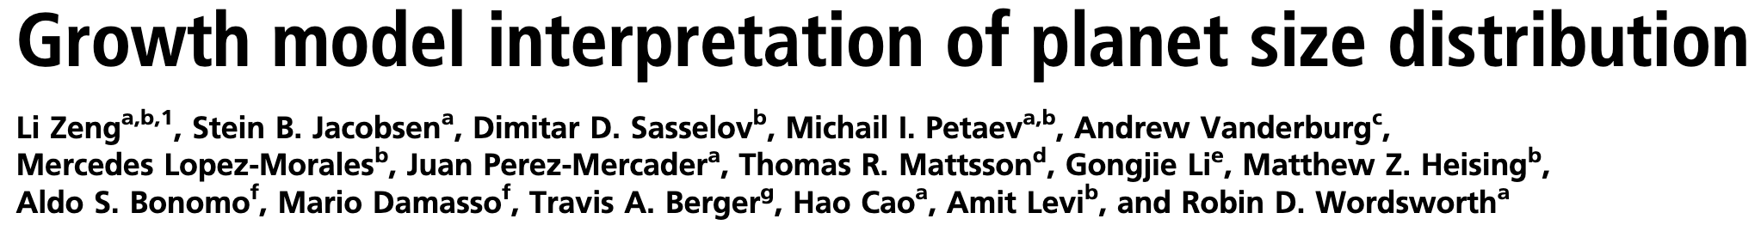
figures
Notes:
audience matters: planet people often love this plot

Slide 18
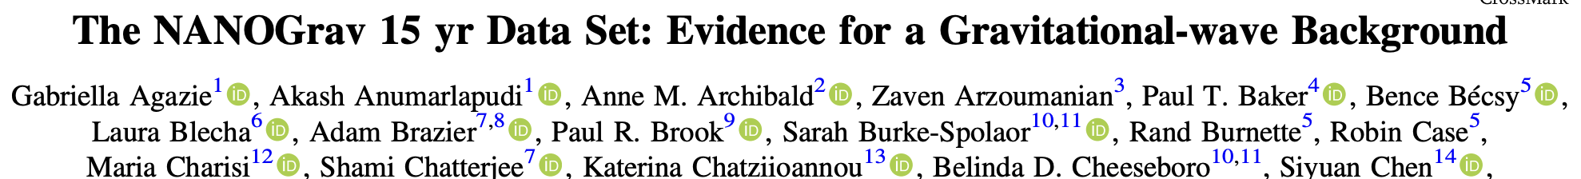
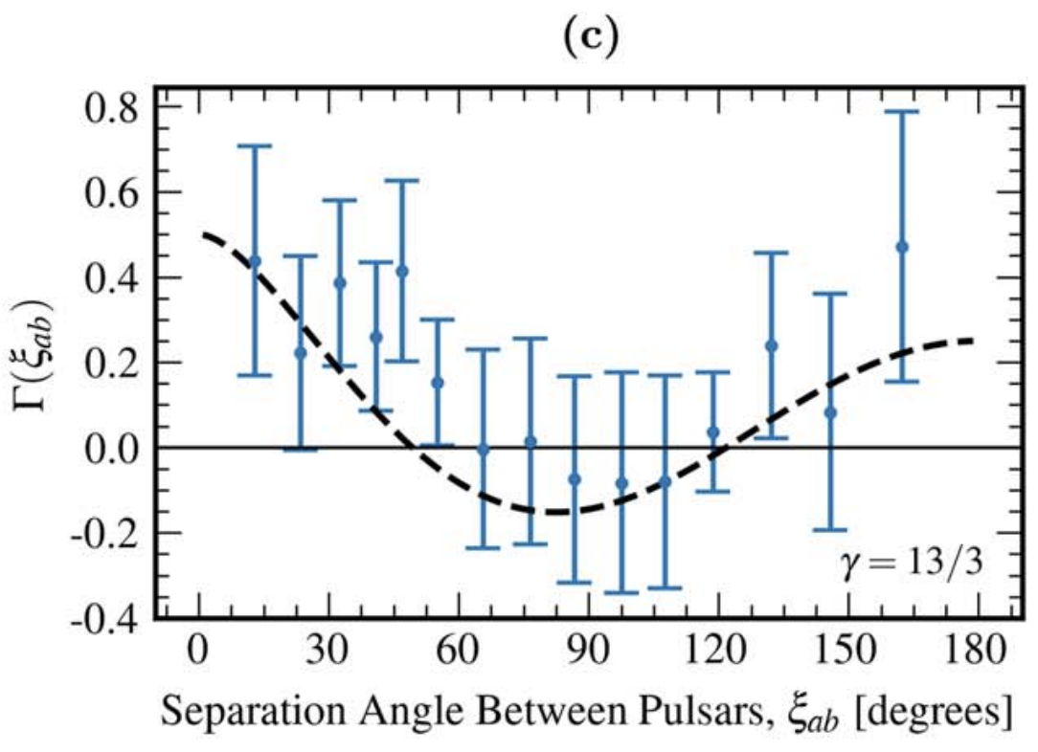
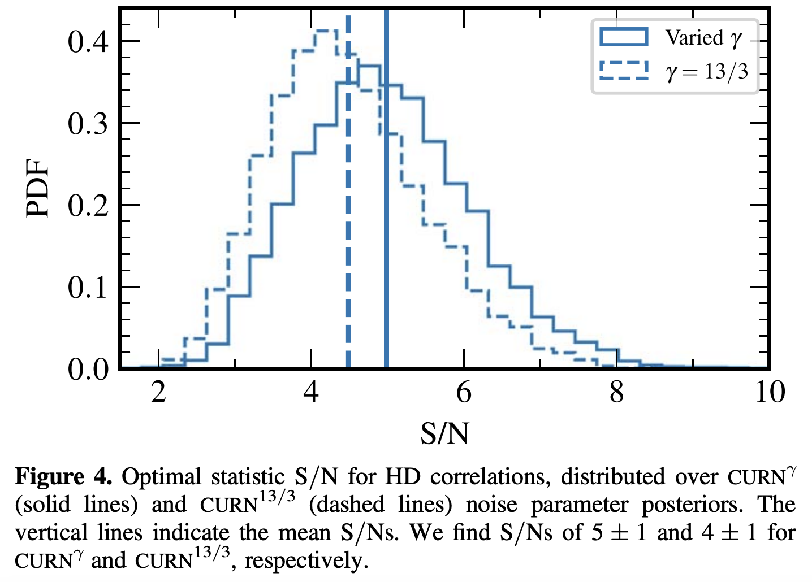
figures
Notes:
First plot shows some data with theory drawn through it; that’s gold
I like that these plots don’t lean just on color to show the different lines (accessibility thing)

Slide 19
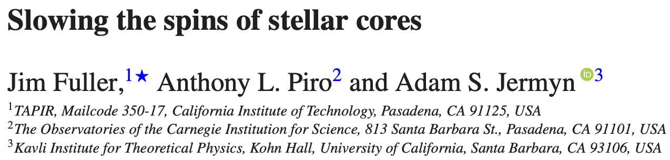
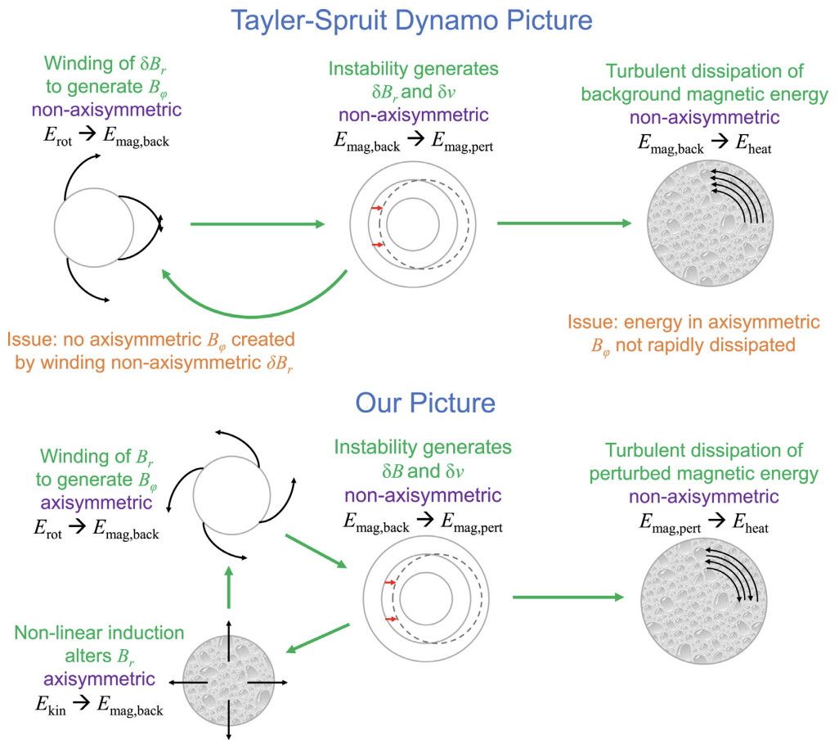
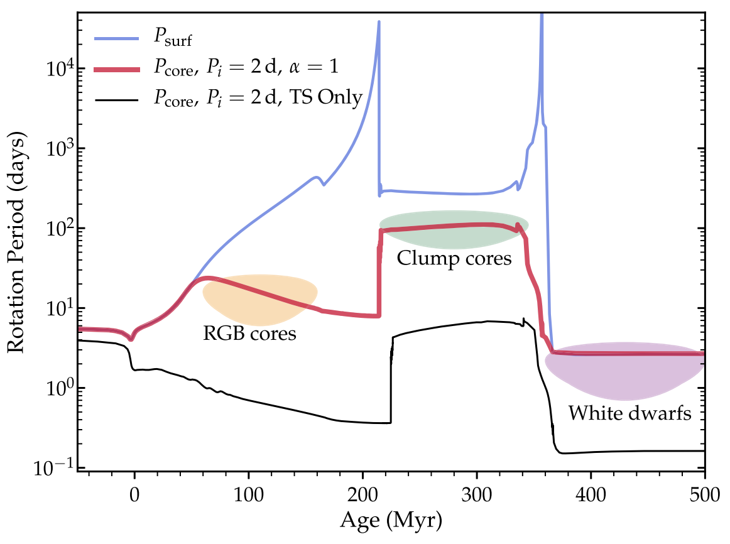
figures
Notes:
left: cartoon
right: line drawn through data

Slide 20
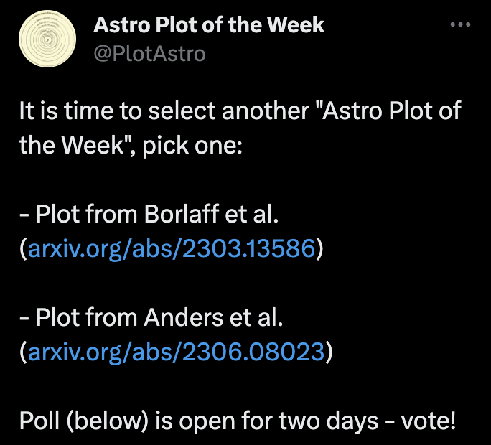
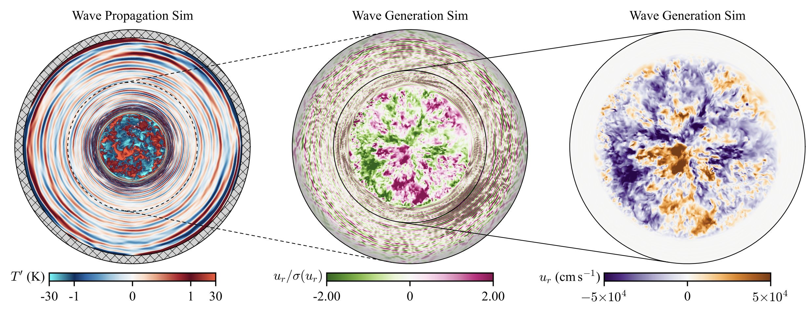
figures
Notes:
pretty picture – also note Astro plot of the week
- I was once told that I should make a plot that others would “copy into their papers”

Slide 21
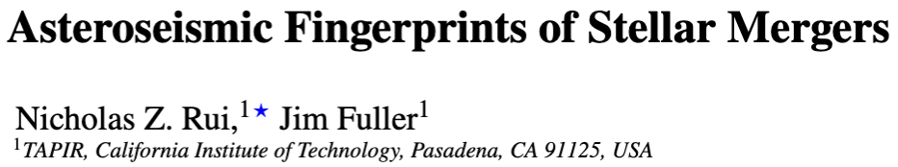
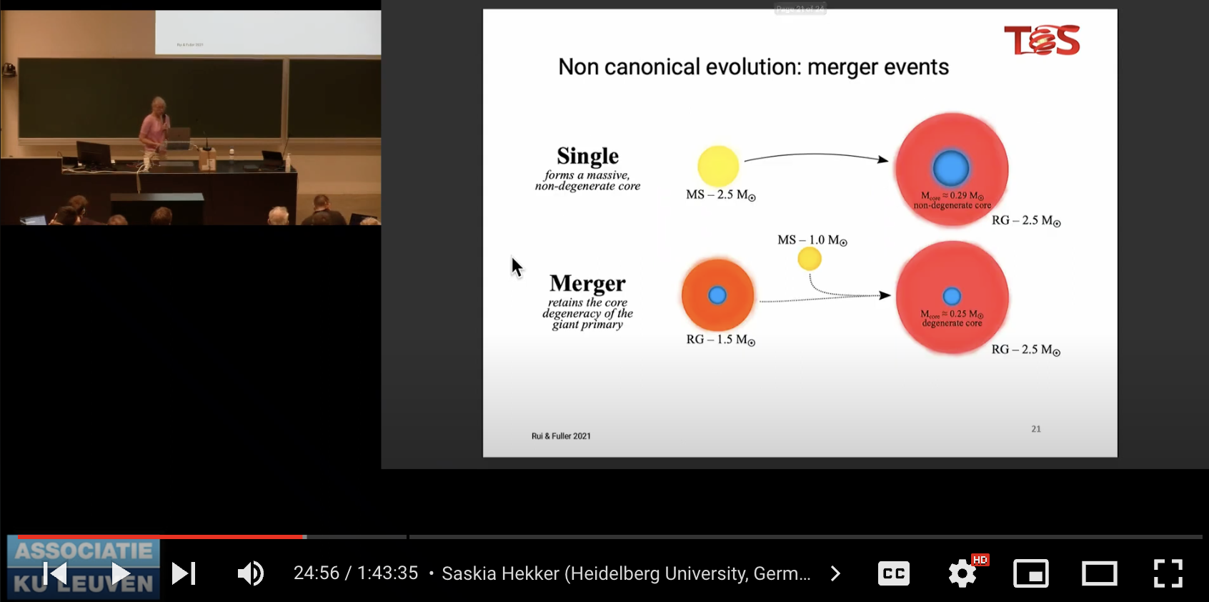
figures
Notes:
good to have a cartoon

Slide 22
writing applications

Slide 23
applications
this is just an essay which is trying to get somebody to do something (accept you)
this is a priority over:
telling the story in order
doing “justice” to time sinks you’ve gone through
giving a detailed account of your work
fitting in
humility & apologizing
acting secure is particularly important here
Notes:
big thing: have a coherent story
Angela Collier video: talk as if you’re a level above what you are (i.e., UG->grad, grad->postdoc, etc.)

Slide 24
common purpose “mistakes”
too long of an introduction
“When I was a kid, I looked to the stars…”
2. not motivating the science / hiding behind jargon
3. emphasizing boring things which take a lot of time
“Midway through my project, the vacuum in my cryostat was broken. Persistently, I repaired...”
4. not providing “evidence”
5. not having a coherent “story”
Notes:
intro:
good to have something short, but these are often very cliché
get to the thesis statement fast, don’t spend multiple paragraphs (or even an especially long paragraph) on your intro
jargon
don’t assume anyone has any idea what you’re talking about, or cares
you can quote numbers, but please try to do some interpretation: is some number big? small? raw numbers are not inherently interesting by themselves
wrong emphasis:
this includes good grades – don’t tell me how diligent you are, unless some class was super duper relevant and you have a qualitative anecdote
just face that this time has gone into a grade and a GPA (number) and that apps care about research
no evidence
give concrete examples of your cleverness or applications of your work – AVOID ABSTRACTION
talk about your deliverables, even if they seem dumb (e.g., group meeting talks)
no story:
don’t just spew all of your life experiences in chronological order and be done with it
you should reread your essay at least once; an important takeaway you want to communicate should appear at the beginning

Slide 25
common security “mistakes”
1. deemphasizing your own contribution
“With my advisor and a graduate student, we examined the behavior of potential superconductors. I contributed to an experiment to...”
“I was tasked with analyzing the distribution of earthlike planets…”
2. emphasizing hardship without a positive message
“Despite experiencing numerous mental health issues throughout undergraduate…”
3. passive language
“Although this project originally focused on nucleosynthesis in binary neutron star mergers, it evolved into a study of how the transient evolves.”
4. emphasizing learning basic technical skills
“In this project, I learned how to use MATLAB in research settings, and discovered that collaboration is central to doing research.”
Notes:
intro:
good to have something short, but these are often very cliché
get to the thesis statement fast, don’t spend multiple paragraphs (or even an especially long paragraph) on your intro
hardship
is ok, but it’s all instrumental to your THESIS
it’s not therapy, and it’s also not dishonest not to tell people things like this
I’m also not convinced it helps a lot with getting people to overlook things you’re insecure about. if you really need to mention this, try to put a positive spin on it
passive voice
your project doesn’t do stuff, you do
basic technical skills
obviously you learned how to code/write/whatever, and don’t tell us about that random machine you learned how to use unless you invented it or something
show, don’t tell, your skills
people probably do this because they don’t know what the takeaway should be – I would maybe just discuss the big-picture implications of your research, deliverables, etc.

Slide 26
giving talks

Slide 27
purpose
length of talk matters: 5 min.? 15 min.? 1 hr?
contributed talk? colloquium? job talk?
audience matters: background? size?
purpose: do you want a job? collaboration? money? is this pedagogical? affect a change of thinking in some field? etc.
most of the time: focus on a single key idea/intuition, since you won’t get much else done
Notes:
ask people how you might give these talks differently, depending on time?
- is it to look impressive? is it to get people to cite your paper? to collaborate with you? to use your code?
most of the time: short talks especially
- key idea, intuition is all you can hope for: will necessarily have to sacrifice material at the altar of brevity
you can LITERALLY SAY “if you take nothing else away from this talk… remember this:”
if they find it interesting, they can talk to you or read your paper and get the real details – it’s sort of like an ad
this works because a talk is not like a paper, it’s not the “record” – it’s not the definitive reference material that should have everything in it

Slide 28
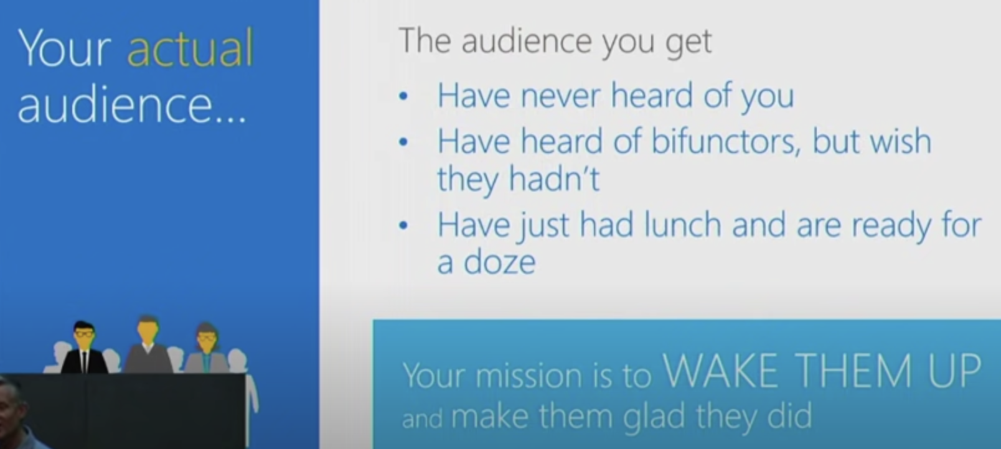
Simon Peyton-Jones

Slide 29
style things
be light on details: they can go to your paper for that
short bullets: no / few complete sentences
figures are key, but be sparse
big, sans serif font, with important words emphasized
try to establish some logical flow
What does this look like in practice?
Notes:
details – be light
equations: try to be self-aware about them at least – I sometimes deliberately say the level at which I want an equation understood (i.e., not)
usually not good to put tables – only put numbers you actually discuss (can’t you just make a fig.?)
complete sentences comes from a tendency to use the slides as a script, which they are not
figures:
- can draw all over them, put arrows or whatever
- prioritize over text
- this isn’t a paper or a version of record, so you can be sloppy and draw all over shit with imprecision
- also, just put a single one (unless you’re specifically intending they not understand it)
put a box at the bottom if you need: Satcher’s advice

Slide 30
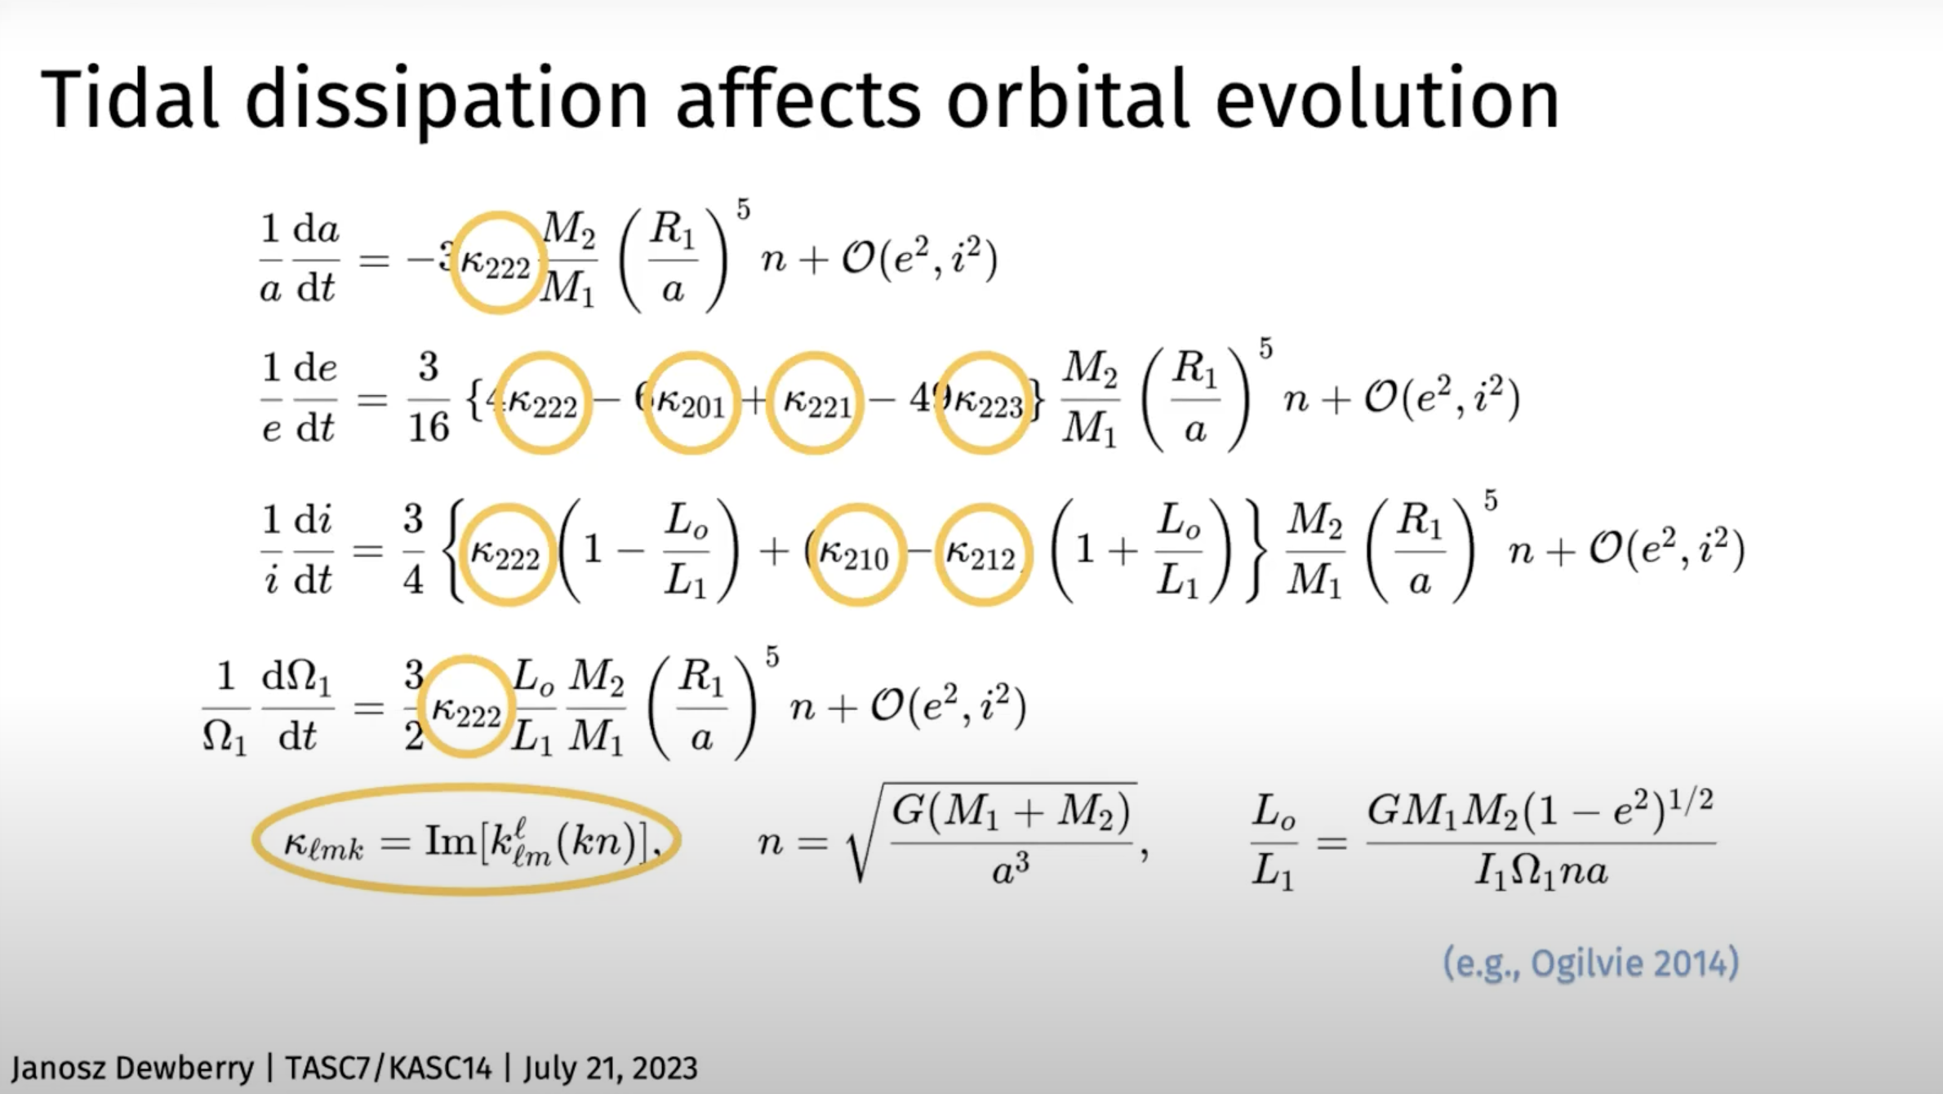
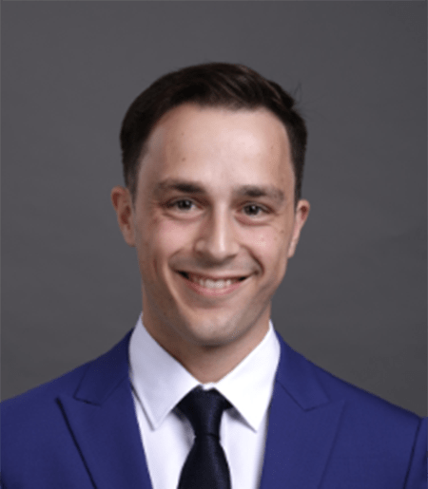
from Janosz’s TASC talk
Notes:
next one is about supernovae

Slide 31
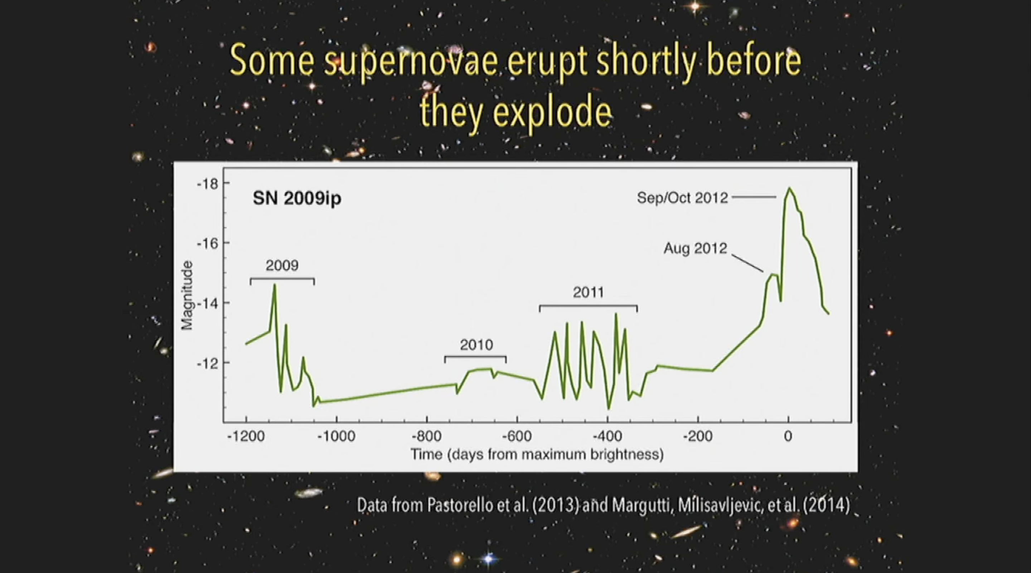
Notes:
the slides in this presentation seemed a little more public-facing

Slide 32
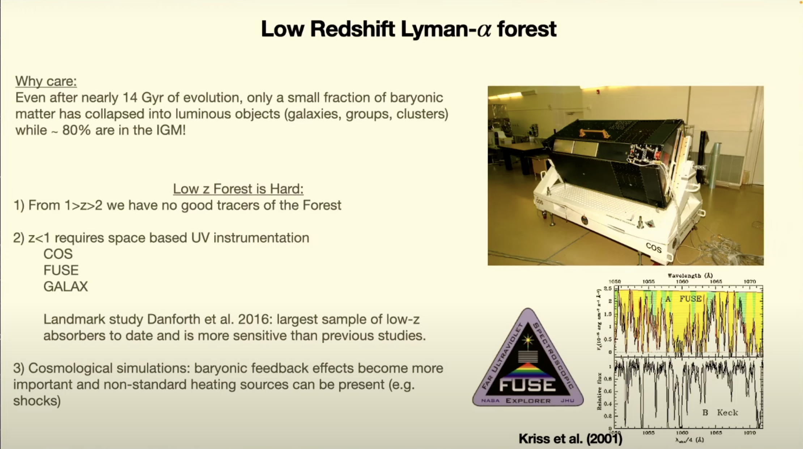
Notes:
cfa colloquium, next one is radio astronomy

Slide 33
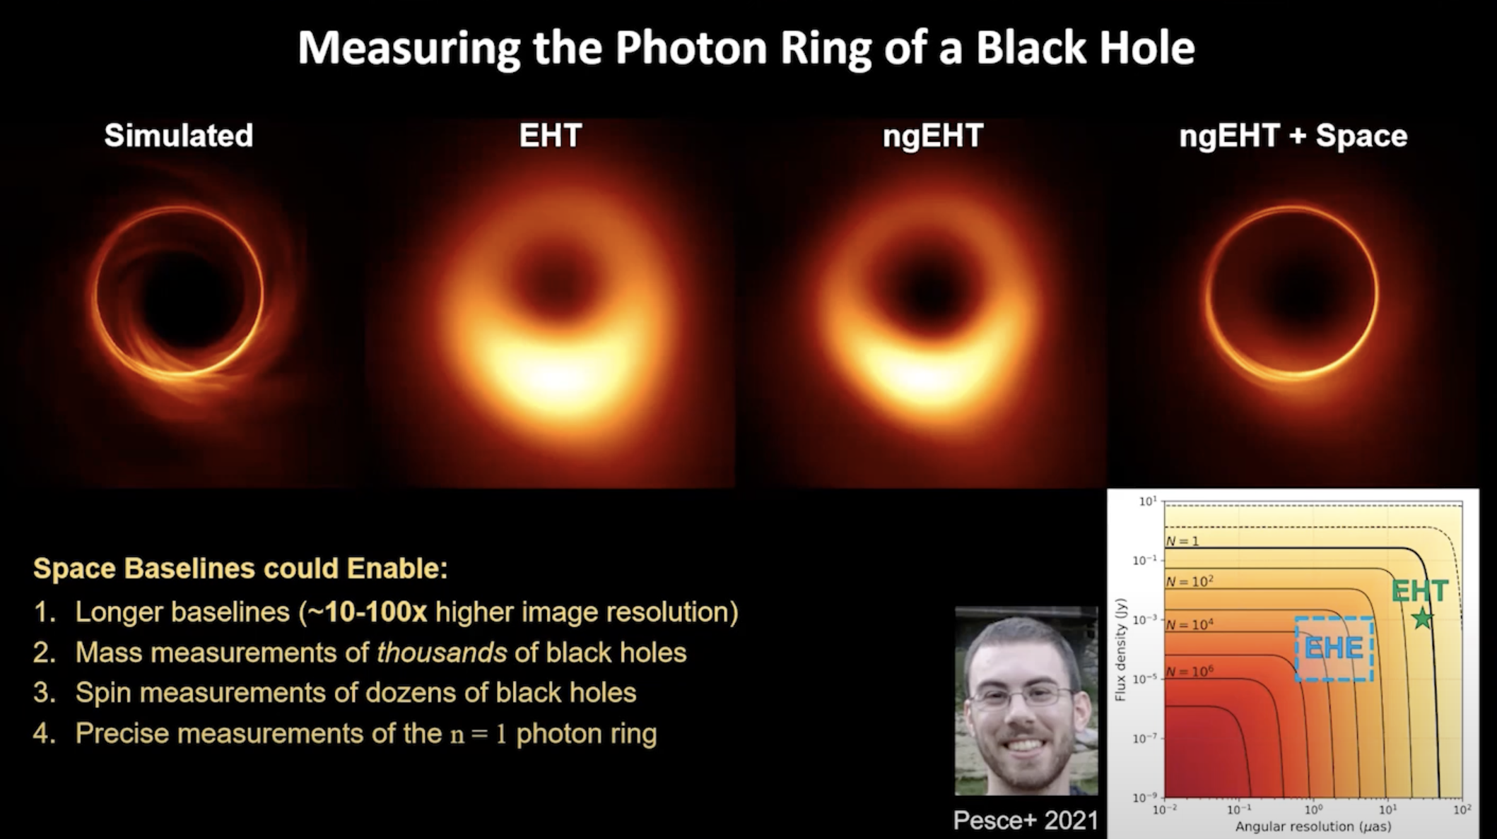
Notes:
next: instrumentation
cfa - colloq

Slide 34
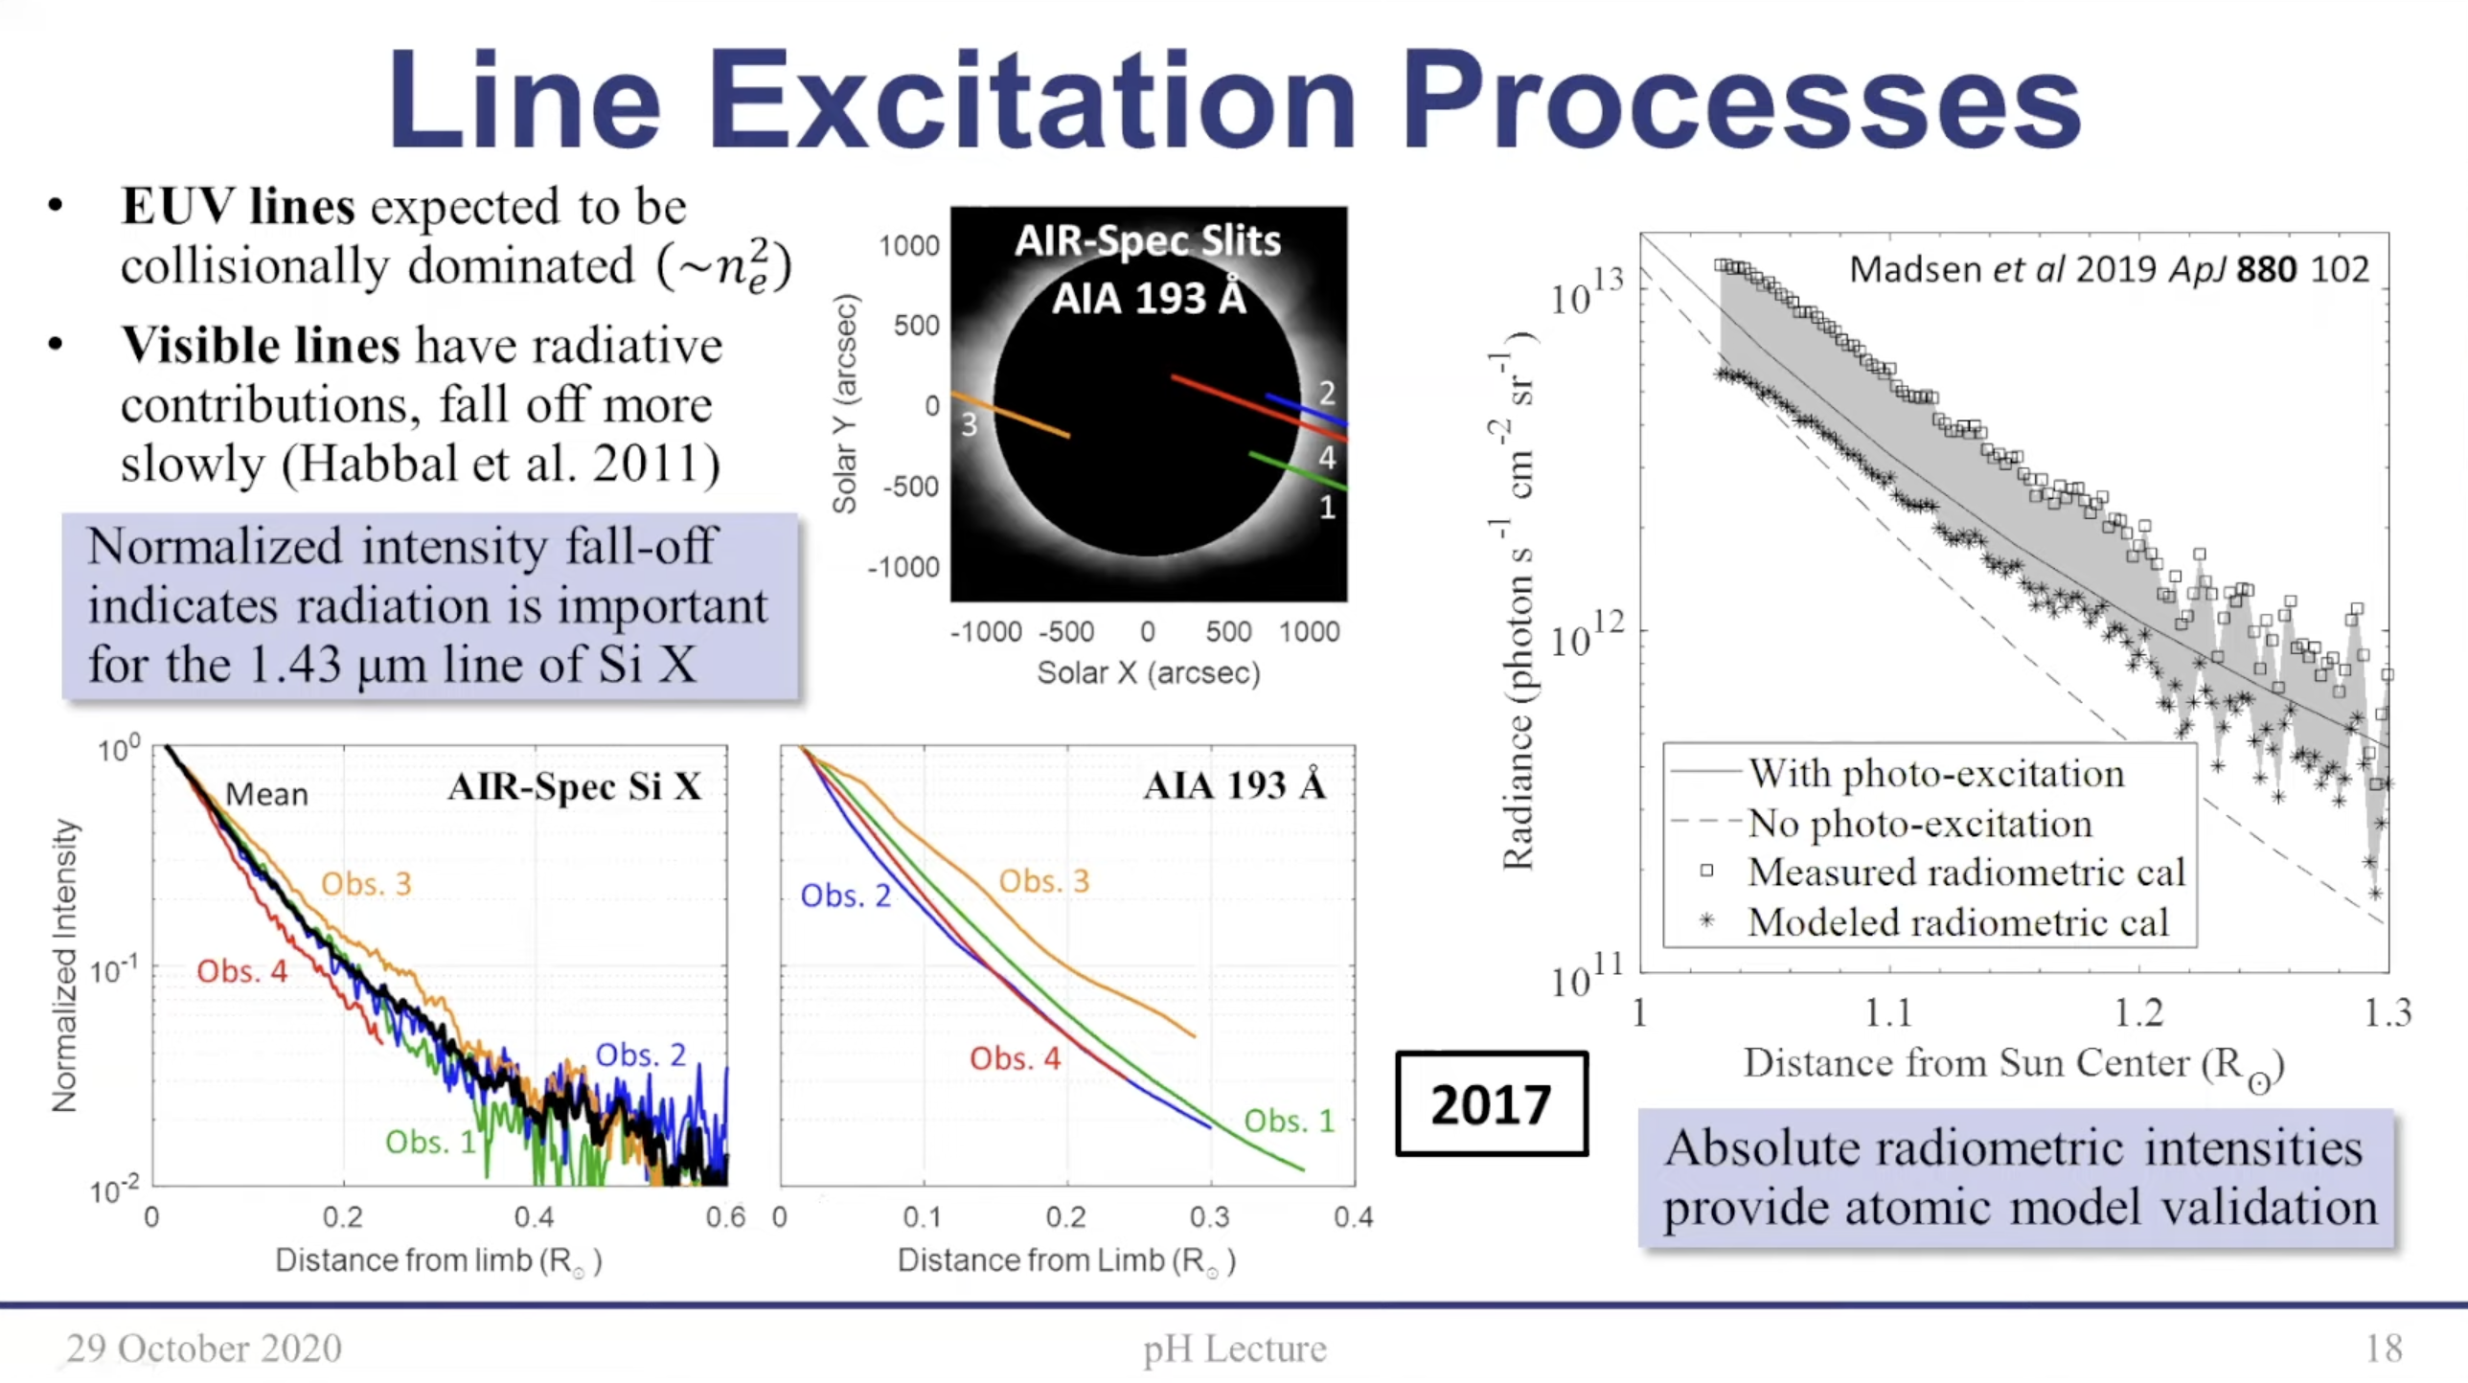
Notes:
cfa – colloq
next one is about magnetogravity waves

Slide 35
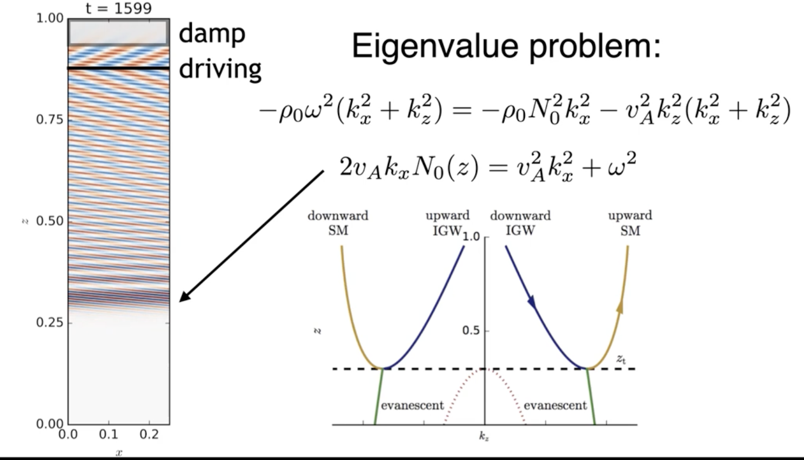
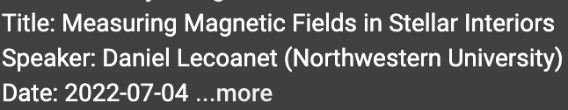
Notes:
cita: more pedagogical
next: elias

Slide 36
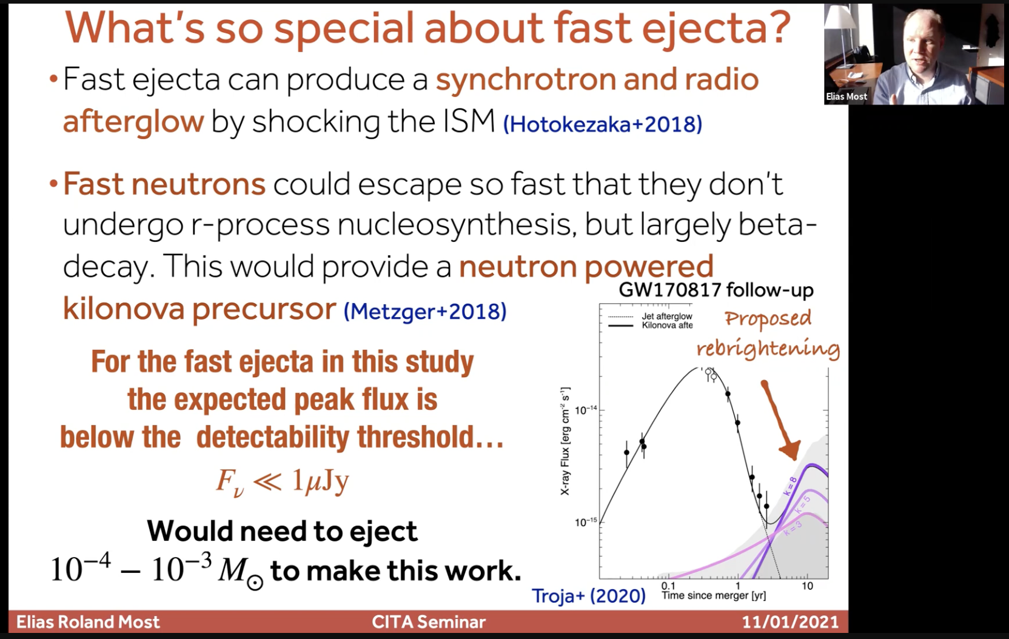
Notes:
next: Emily (public)

Slide 37
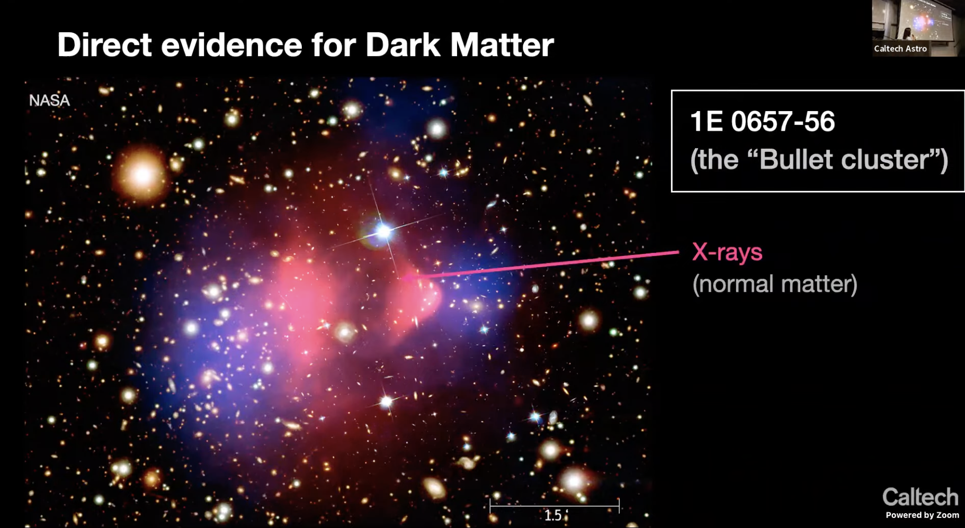
Notes:
stargazing lecture
next: nils

Slide 38
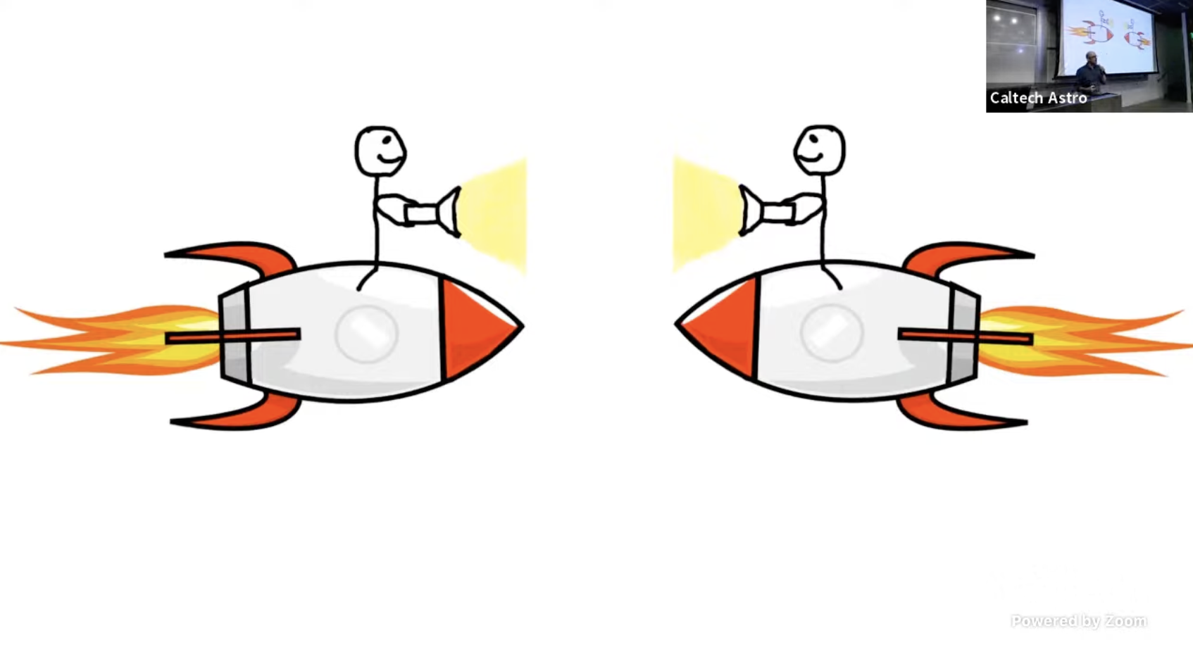
Notes:
stargazing
next: jacob

Slide 39
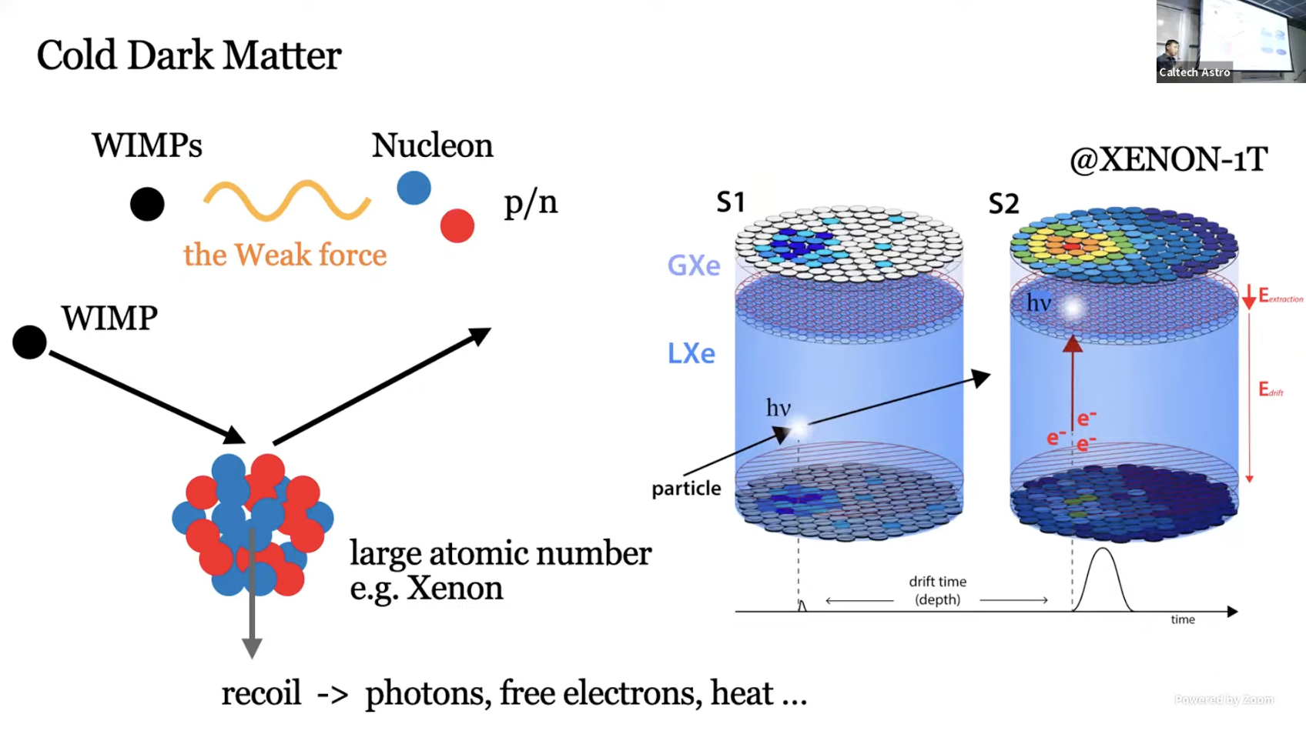
Notes:
stargazing
next: starspots

Slide 40
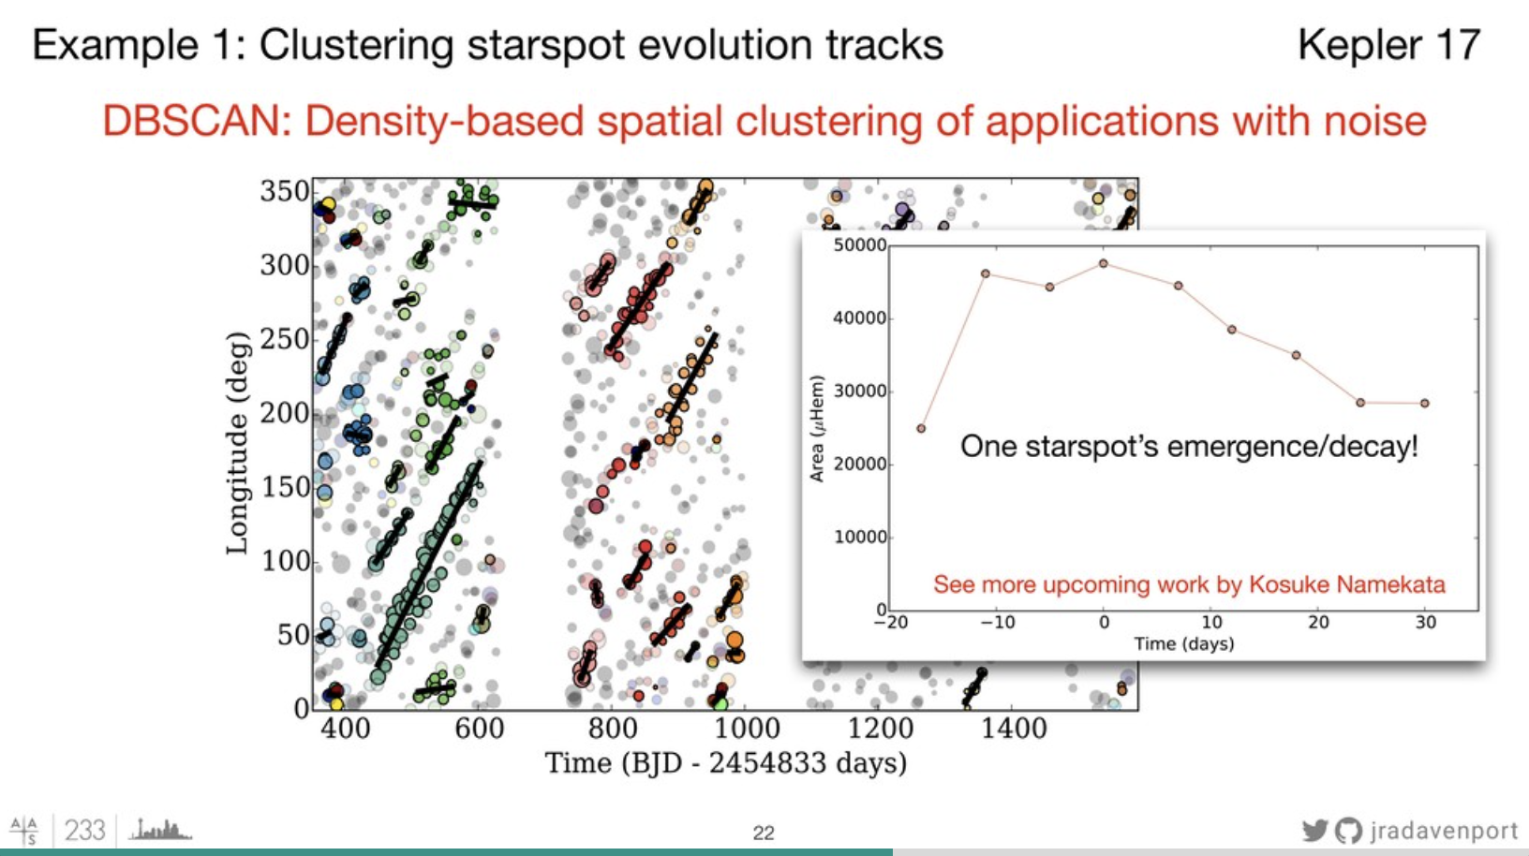
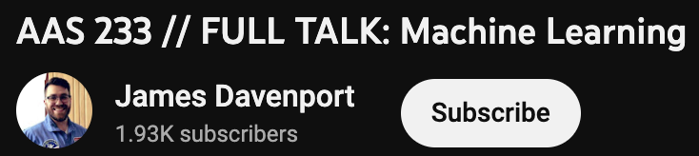
Notes:
~20 min talk at aas
next: plasma

Slide 41
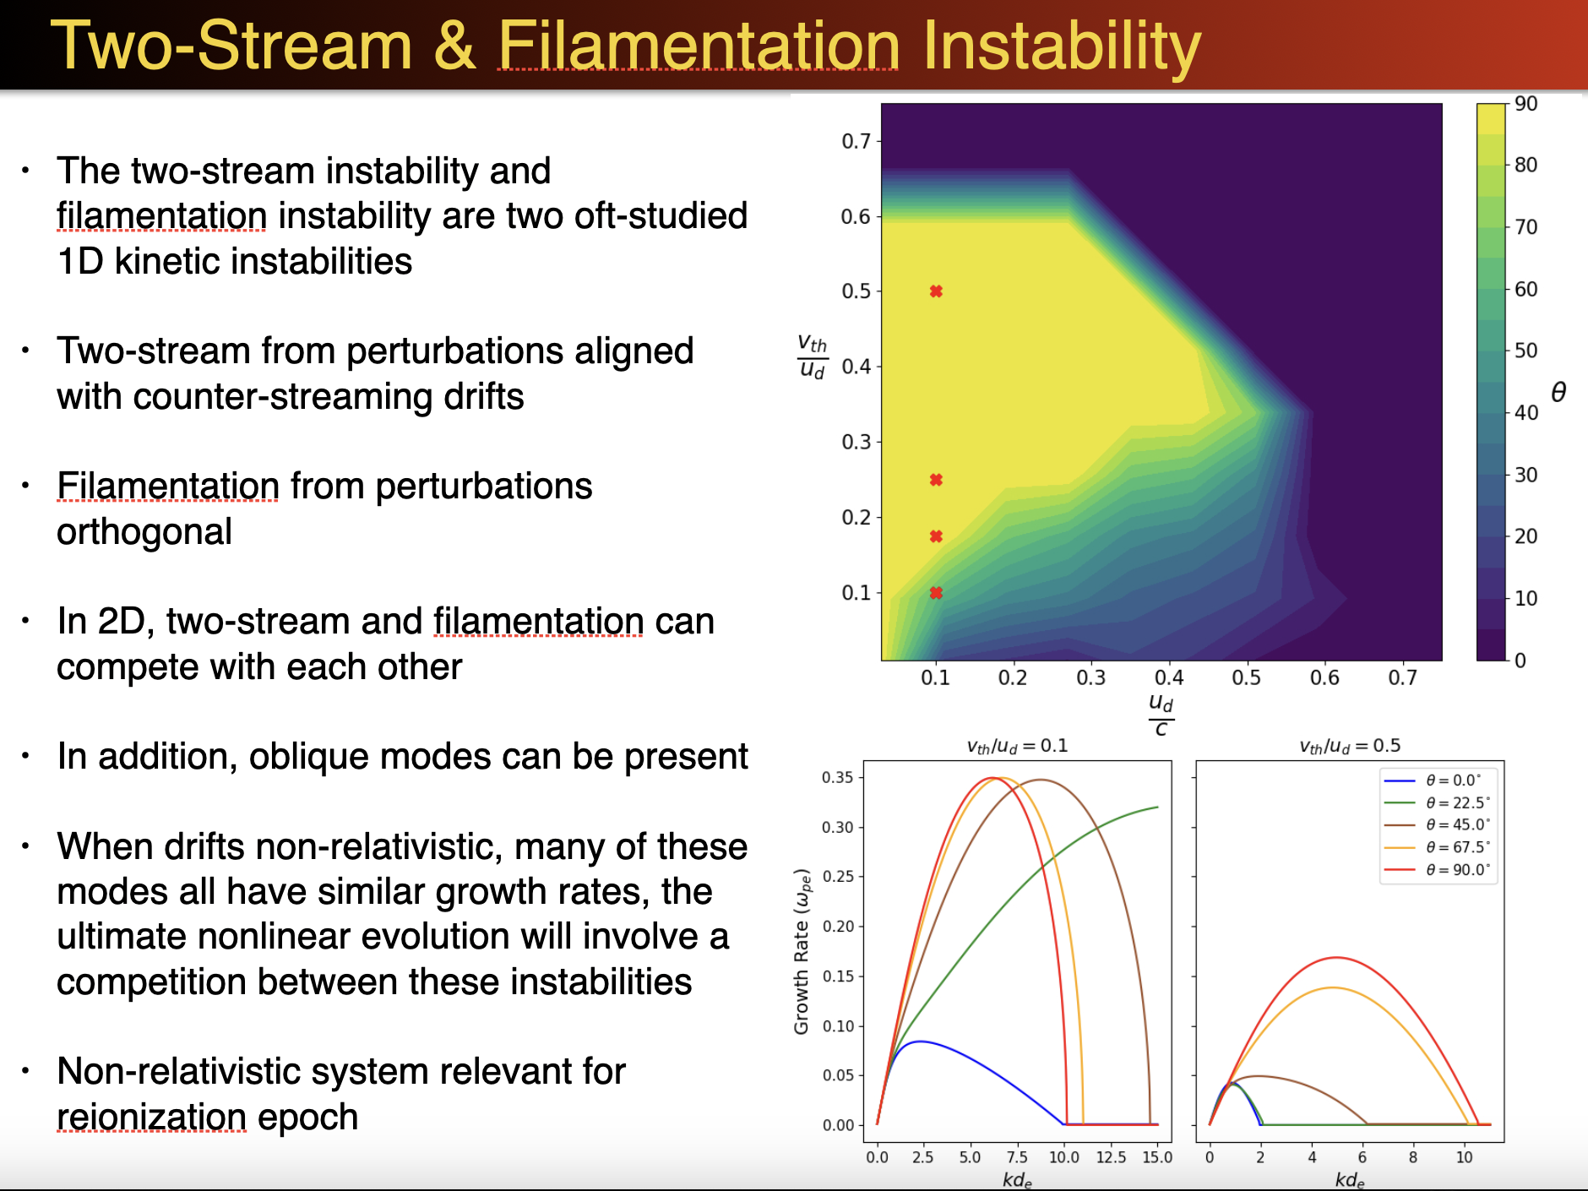
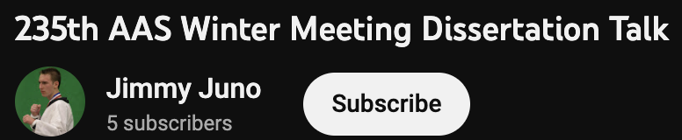
Notes:
aas, ~20 min
next: 5 min SMBHs

Slide 42
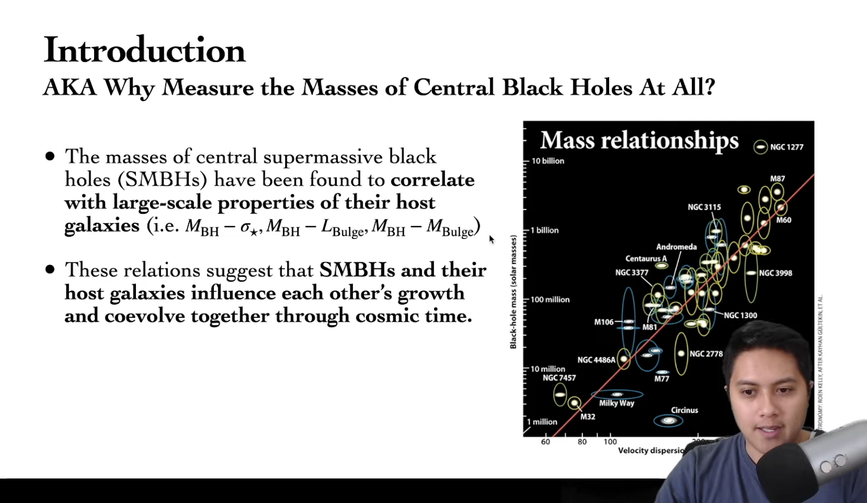
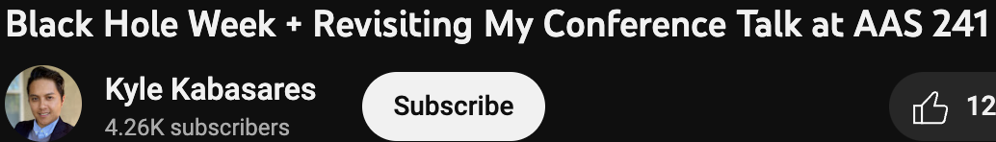
Notes:
5 min aas

Slide 43
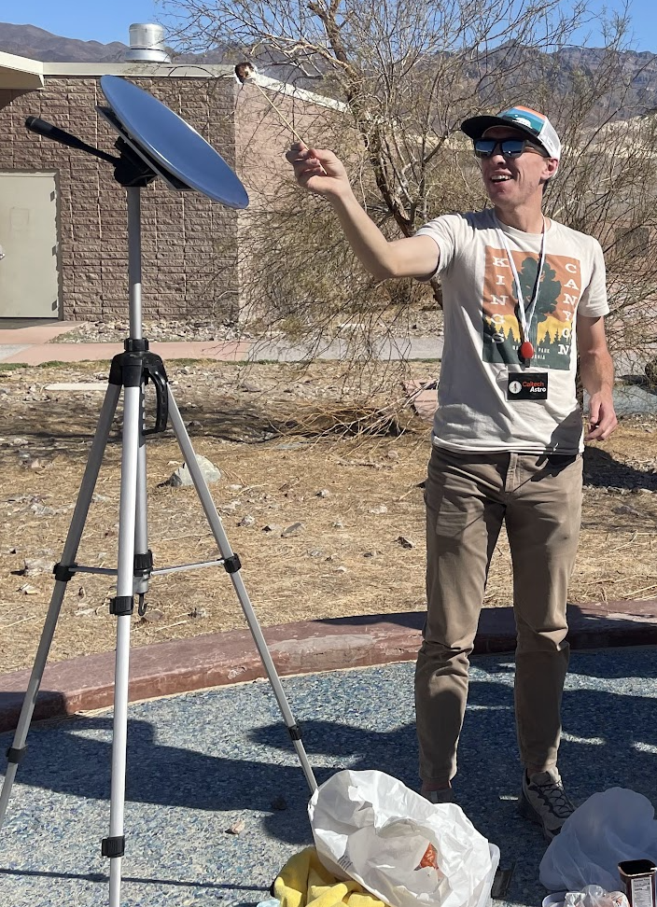
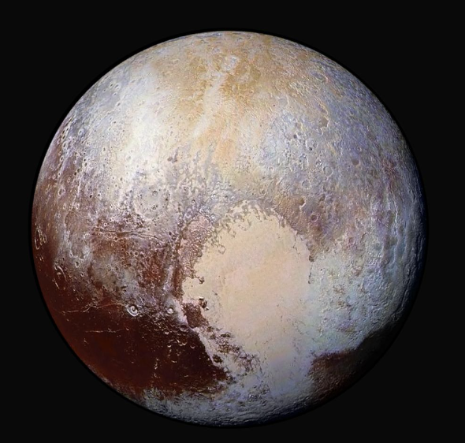
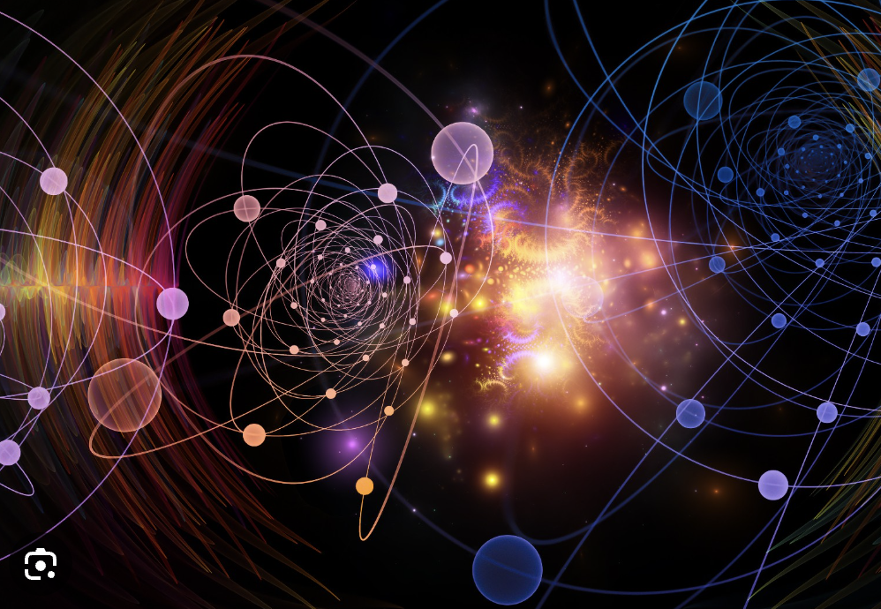
talking to the public
empower the audience, not yourself
Notes:
ask people what they think about this – how do differently?
picture on the right is what came up when I searched “quantum mechanics”
sci comm
nobody knows anything, and what they may be interested in may not be what you care about
quantum gravity, quantum mechanics
pluto
distances to other objects
astronomy is easy to get interest for
purpose:
really up to you, you can either awe them or try to give them intuition for things — i like the latter, but it’s a little idealistic to expect people to actually remember stuff
draw upon intuition
avoid jargon (obviously)
my gripe: do not make the purpose be for people to think you’re smart — good public sci comm is trying to make science feel accessible/attainable (ESPECIALLY for kids)
personal examples:
wide-eyed girl at a berkeley stem event after having the link between wavelength and color explained
cameron hummels, parabolic, marshmellows
can ask the people in your life to listen to stuff

Slide 44




Research papers: https://www.youtube.com/watch?v=VK51E3gHENc
Research proposals: https://www.microsoft.com/en-us/research/academic-program/how-to-write-a-great-research-proposal/
Research talks: https://www.youtube.com/watch?v=sT_-owjKIbA
How to unsuck your PowerPoint slides! (Dennis Meridith): https://www.slideshare.net/DennisMeredith/how-to-unsuck-your-power-point-slides-250154776#1
Applications (Angela Collier): https://www.youtube.com/watch?v=tz42lx6BhqY

Slide 45
always keep the purpose in mind!

