Slide 1
Tasting the Gravitational Rainbow
Expanding the accessible spectrum of gravitational waves
Andrew Laeuger

Slide 2
A Collection of Random Things I’ve Done
With a sufficiently vague subtitle to make it seem like I had a recurring theme the whole time
Andrew Laeuger

Slide 3
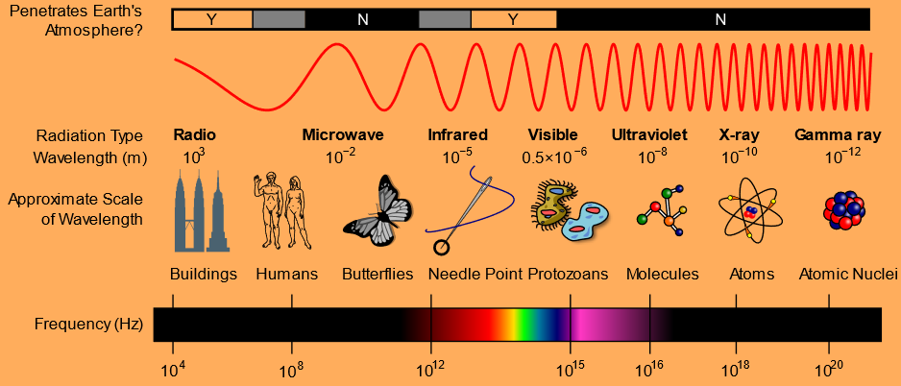
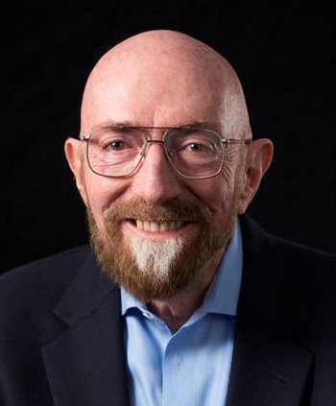
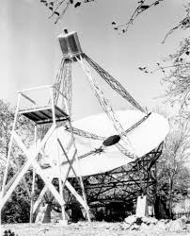
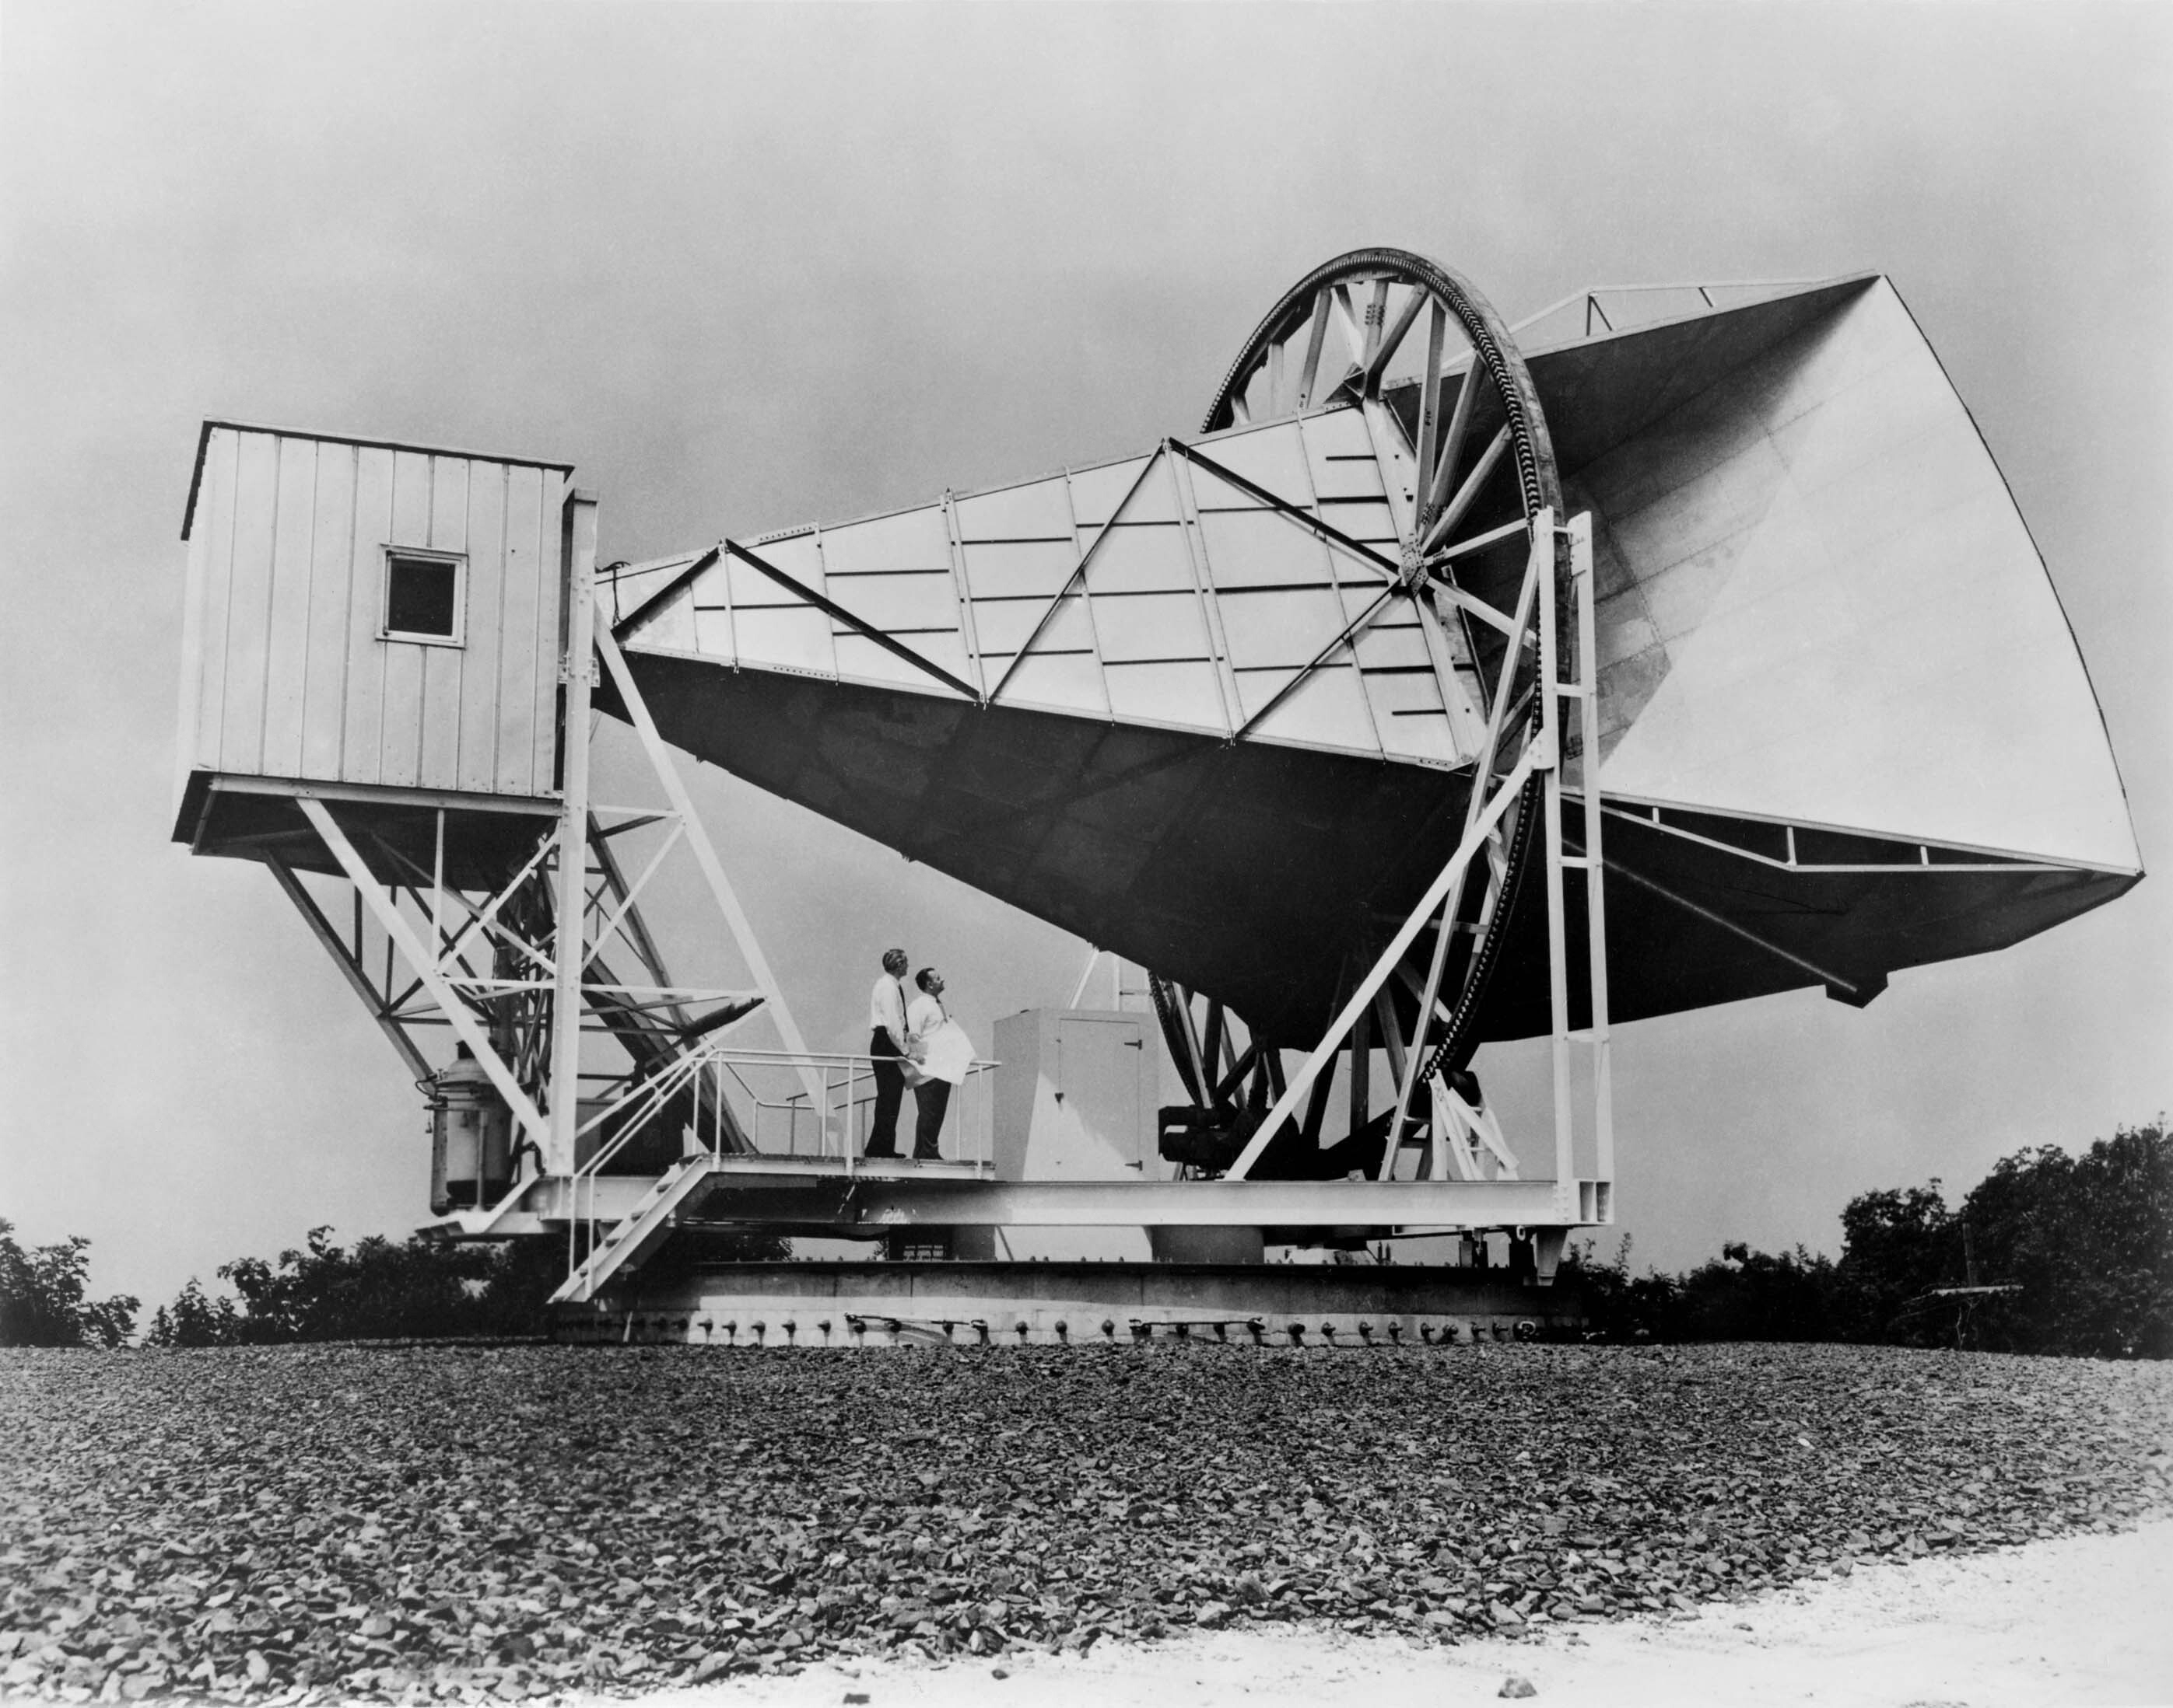
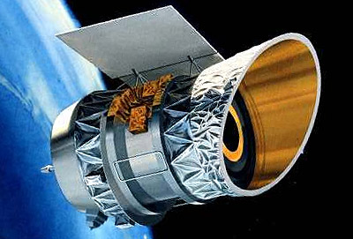
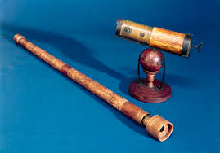
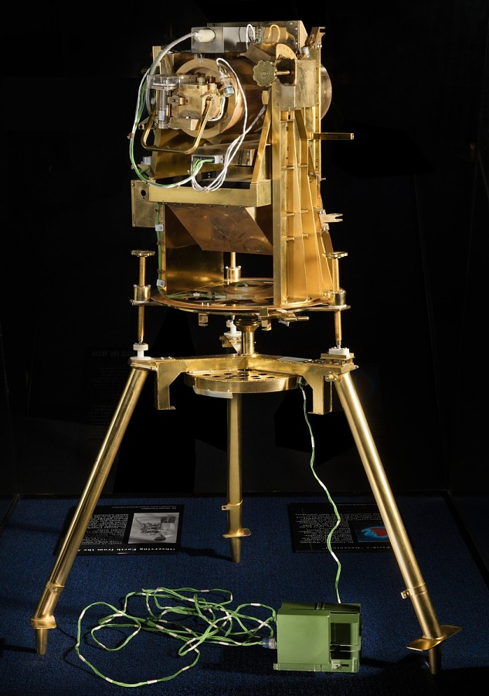
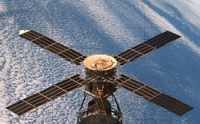
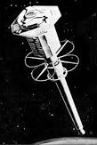
The electromagnetic spectrum
1937
1959
1983
1608
1972
1973
1961

Slide 4
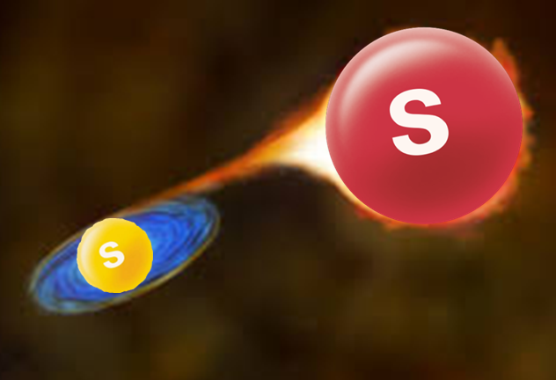
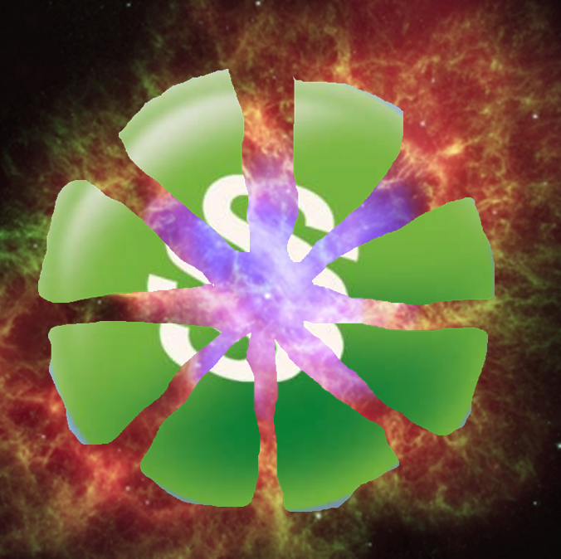
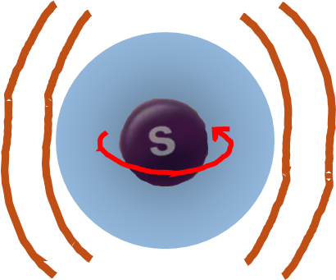
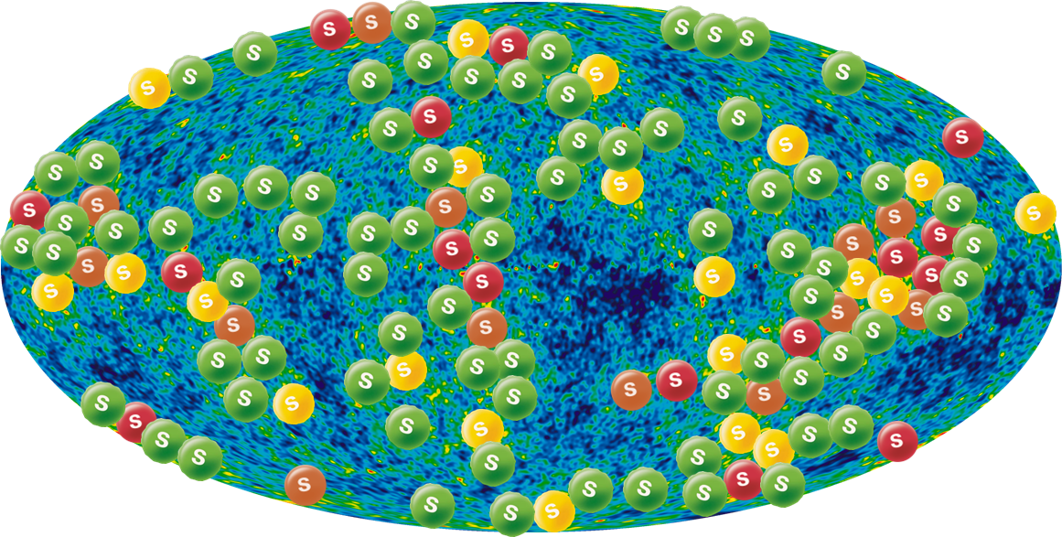
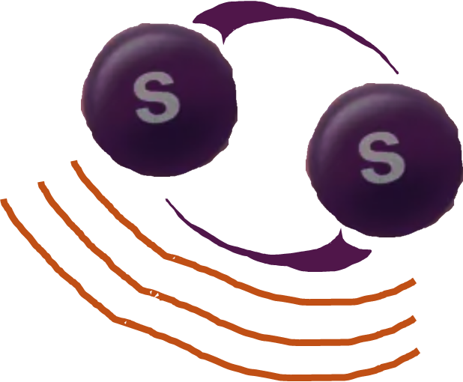
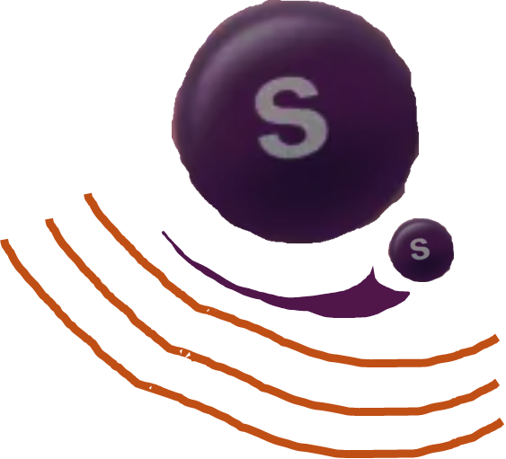
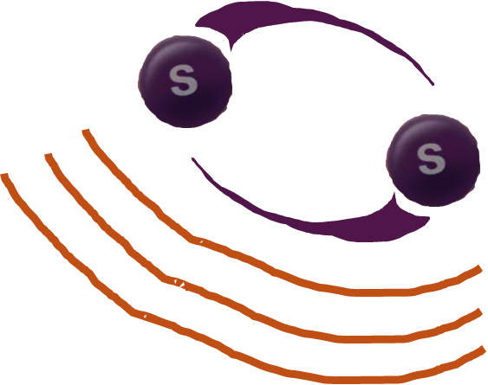
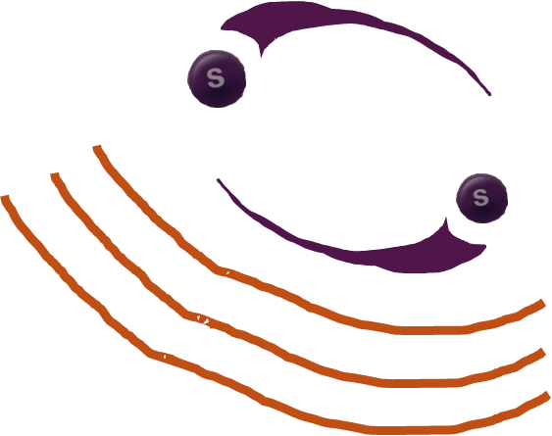
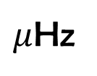
The gravitational wave spectrum: what is there to find?
Compact object mergers: the bigger they are, the softer they fall
  SMBHs at nHz, EMRIs & WDs at mHz, stellar-mass objects at Hz, PBHs at kHz
Core collapse supernovae: oscillations of the neutron star
Big Bang: quantum fluctuations during inflation
Exotic sources: dark matter (axions), early universe phase transitions, cosmic strings
nHz
$μ$Hz
mHz
Hz
kHz
MHz

Slide 5
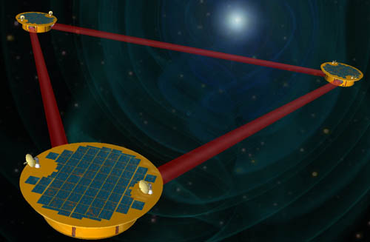
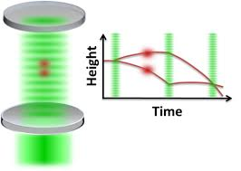
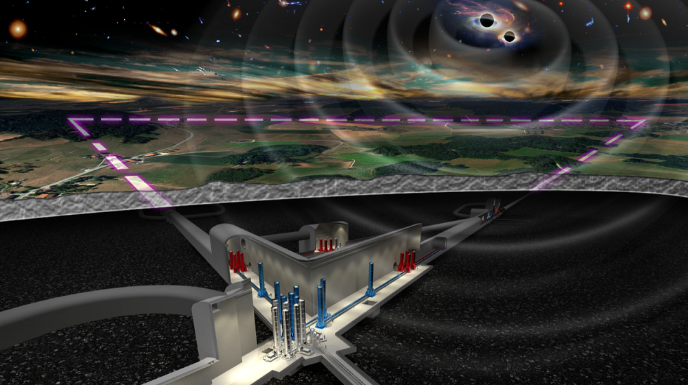
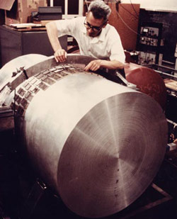
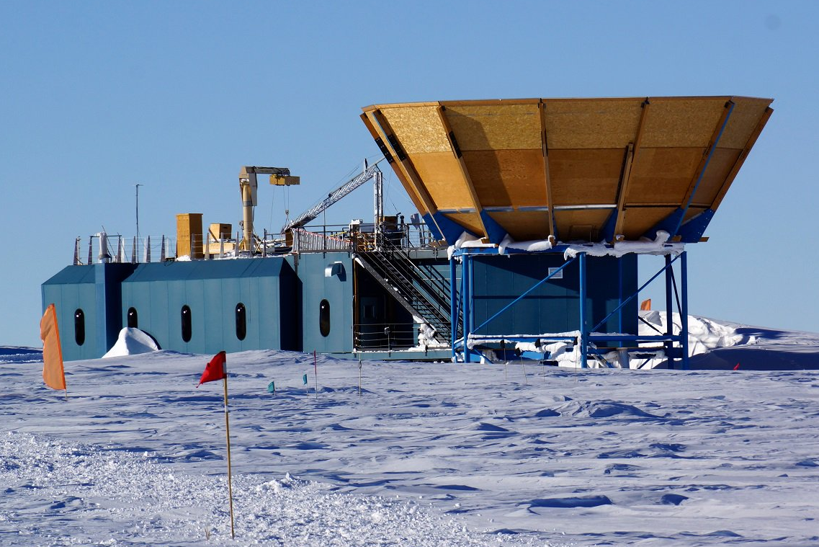
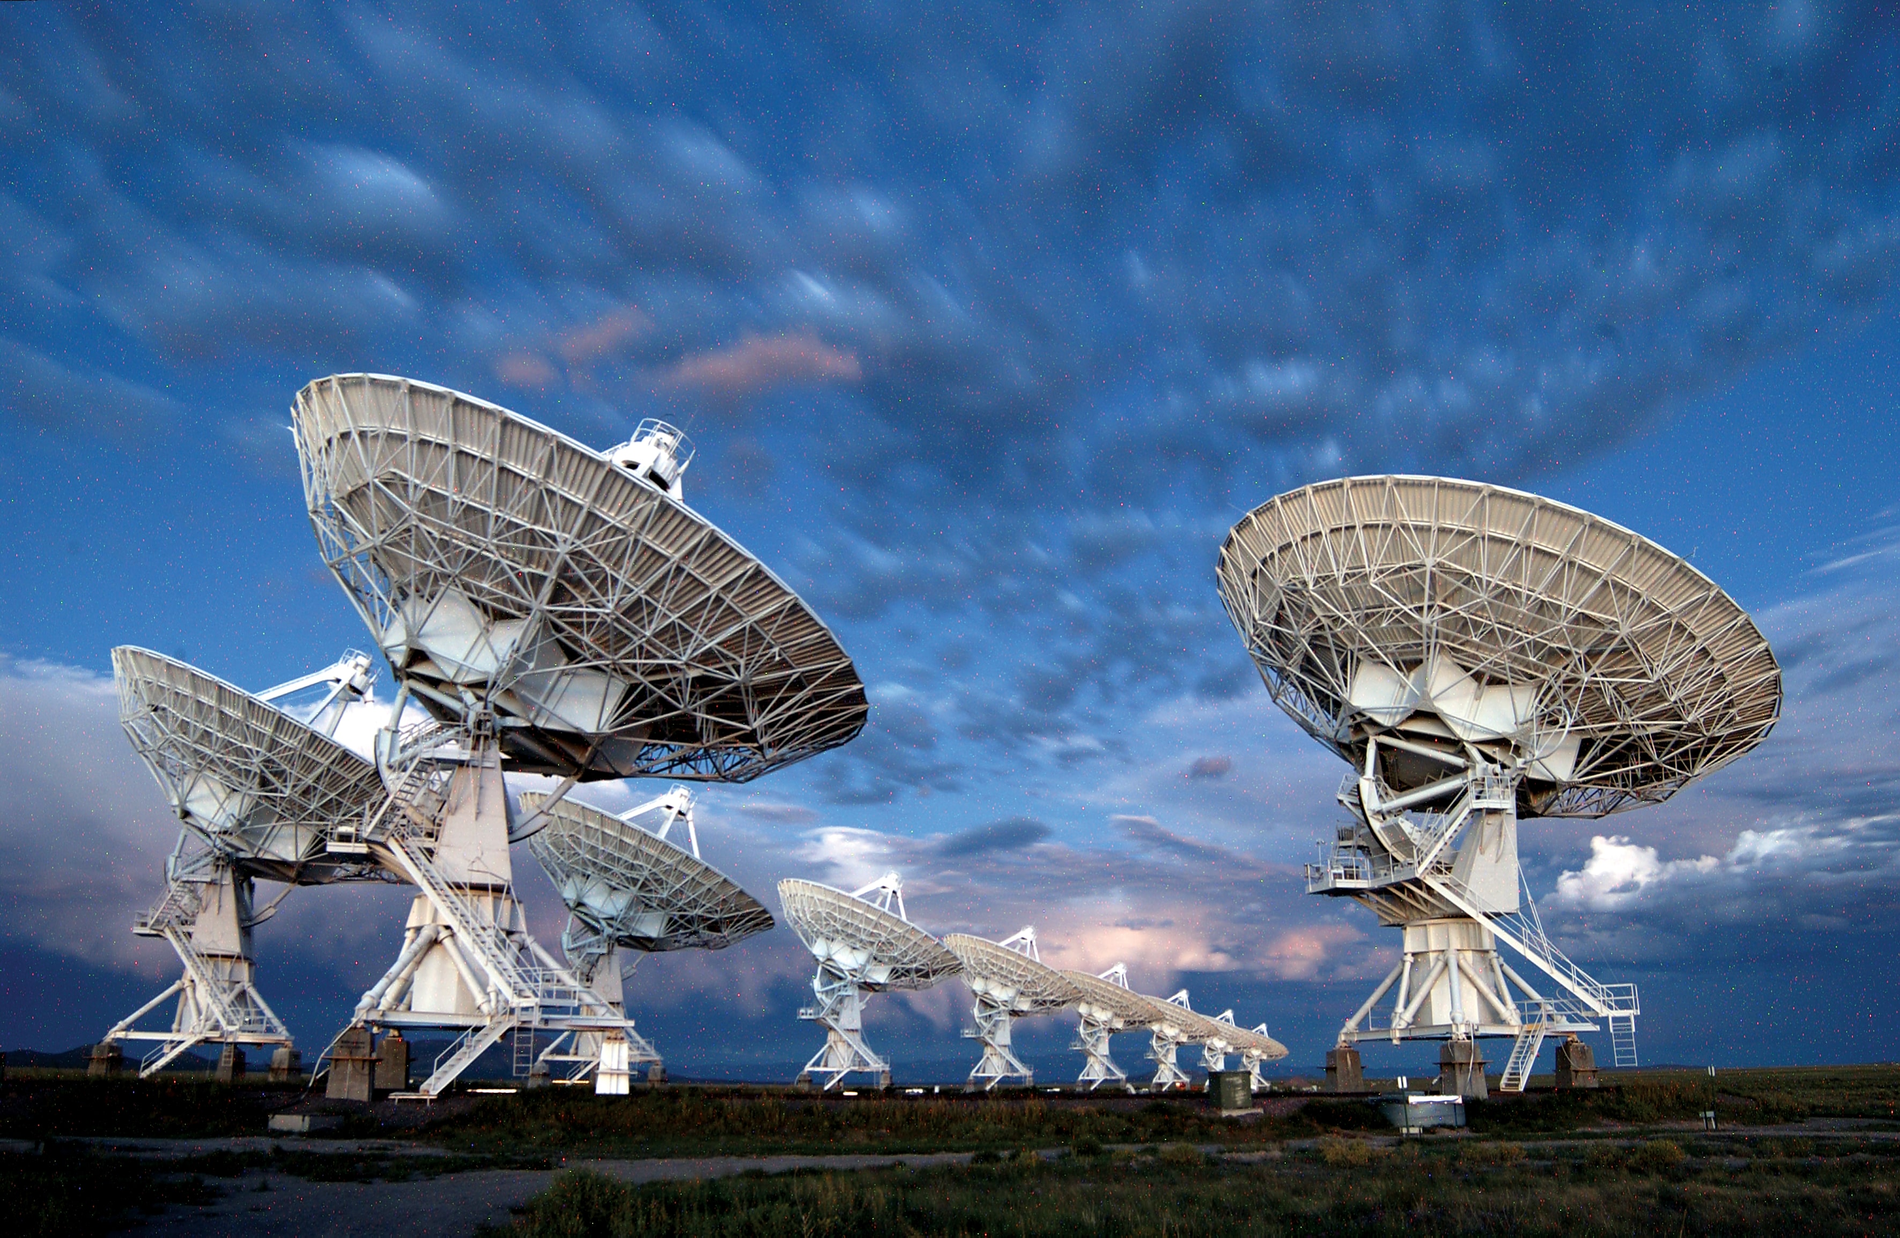
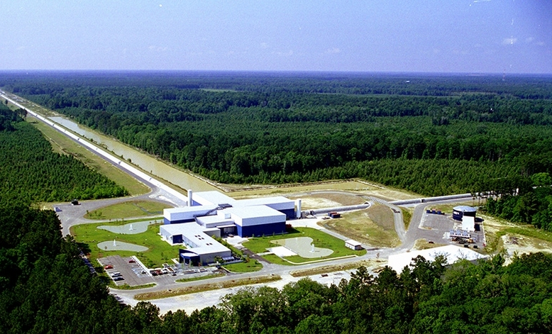
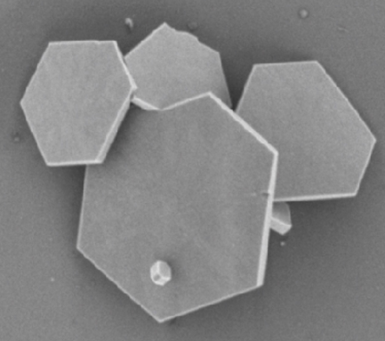
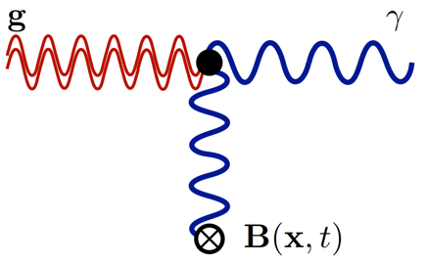
The gravitational wave spectrum: how are we searching across it?
Resonant bars: from Weber in 1968 until today
Laser interferometers: LIGO (2015), Virgo (2017), KAGRA (2027?)
Pulsar timing arrays: NANOGrav, PPTA, EPTA, InPTA (2023), CPTA, MeerKAT
Next-gen interferometers: upgrades, Cosmic Explorer, Einstein Telescope (2030s?)
Space-based interferometers: LISA (2035?), DECIGO, TianGO
Indirect detection: B-modes in CMB (BICEP, CMB-S4)
Other AOM experiments: MAGIS-100 atom interferometer, microwave cavities (Gertsenshtein effect), levitated nanoparticles (2030s?)
nHz
$μ$Hz
mHz
Hz
kHz
MHz

Slide 6
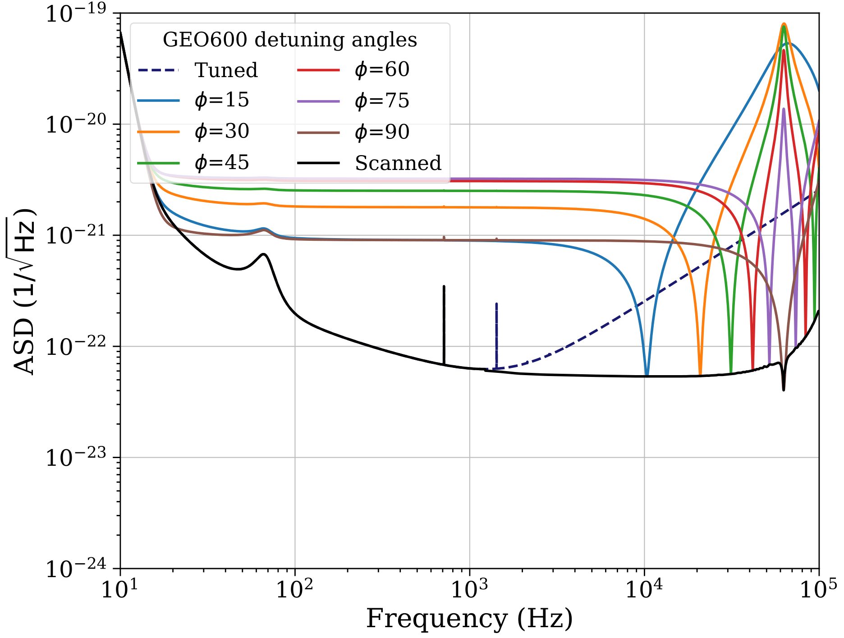
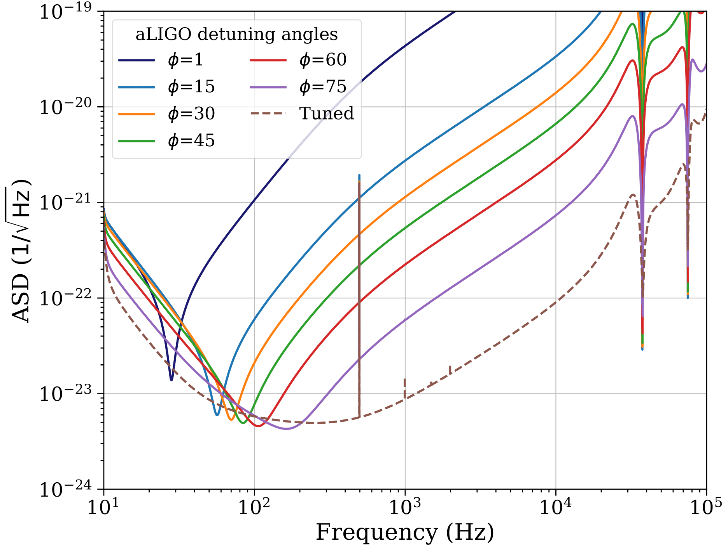
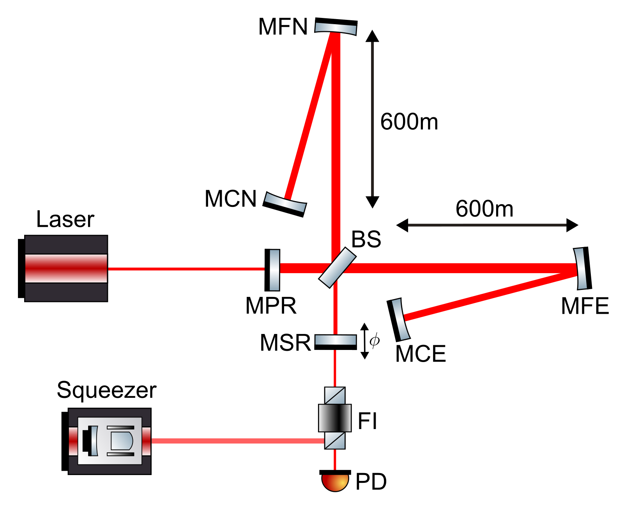
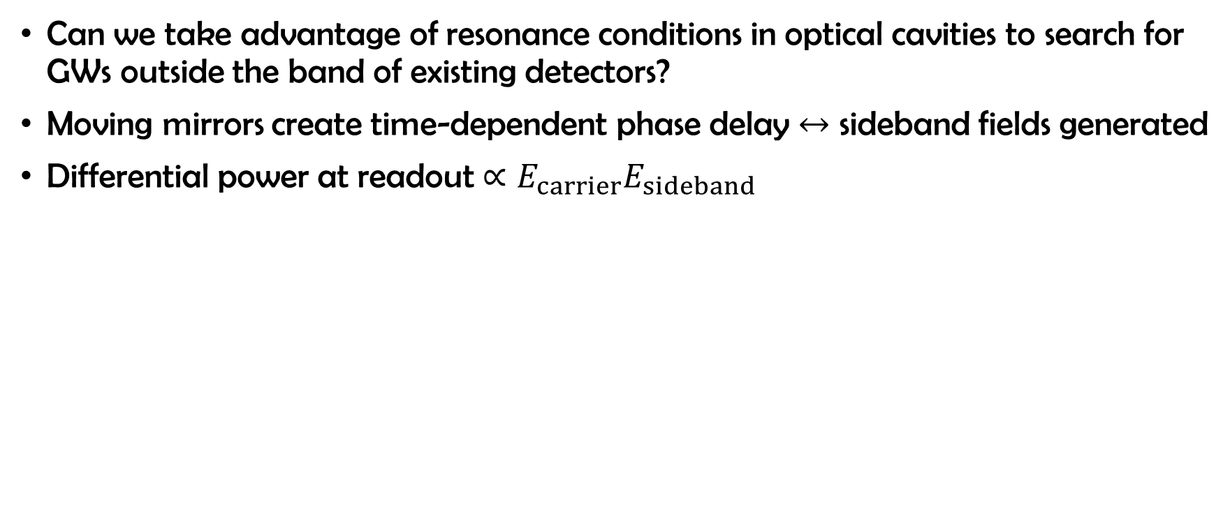
High Frequency GW Detection: A case for repurposing existing infrastructure
Can we take advantage of resonance conditions in optical cavities to search for GWs outside the band of existing detectors?
Moving mirrors create time-dependent phase delay $↔$ sideband fields generated
Differential power at readout $∝E_{carrier}E_{sideband}$
GEO600
In collaboration with Chris Jungkind and Brian Seymour

Slide 7
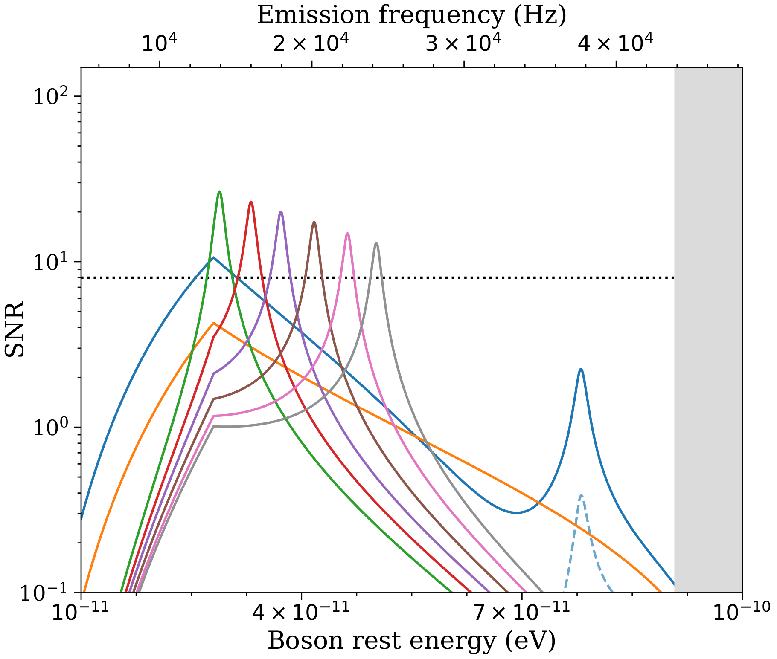
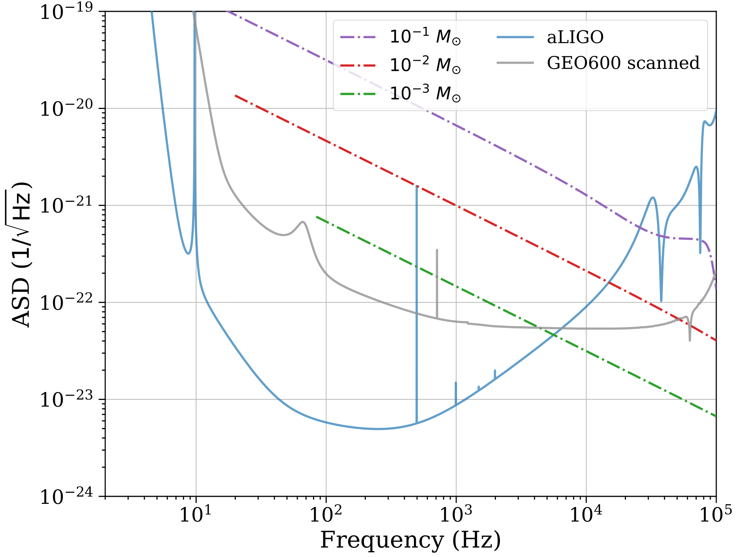
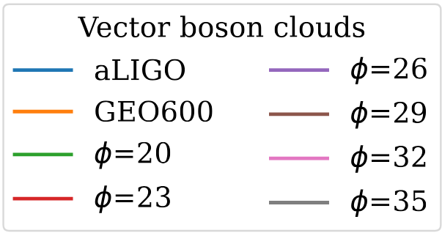
High Frequency GW Detection: A case for repurposing existing infrastructure
Does this modification to GEO600 make it competitive at high frequencies?
Improved SNR is possible for exotic monochromatic sources (galactic axion clouds)
However, there is no advantage for detecting transients (sub-solar mass mergers)
In collaboration with Chris Jungkind and Brian Seymour

Slide 8
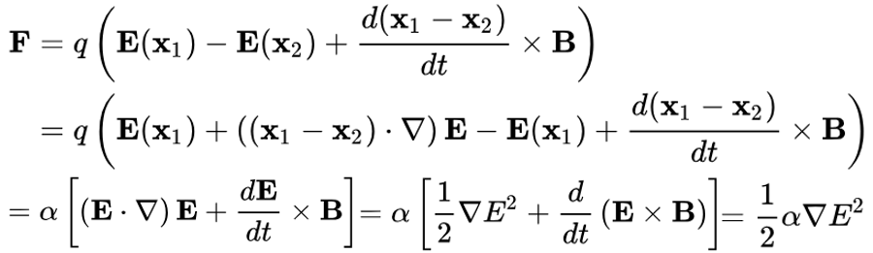
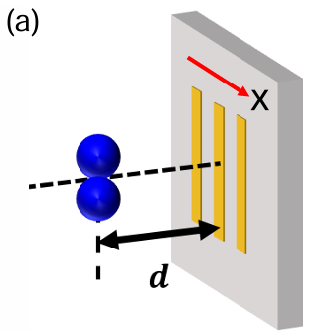
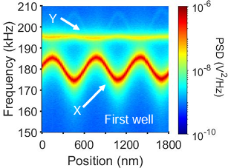
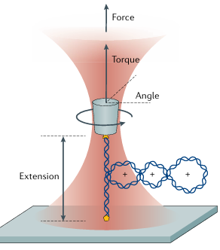
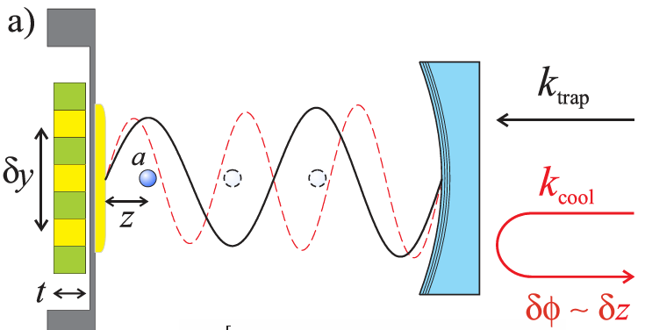
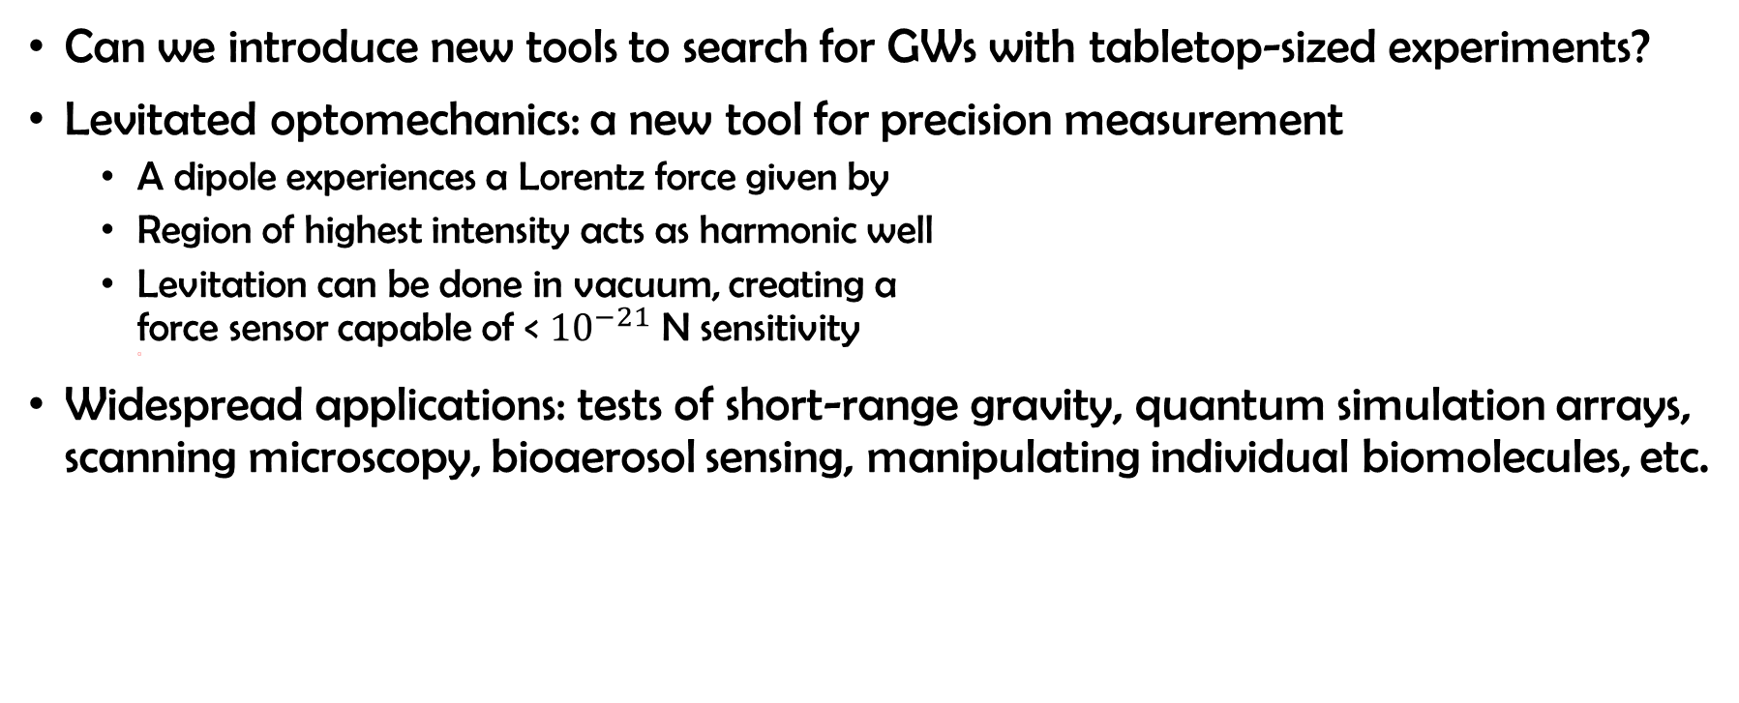
High Frequency GW Detection: A case for brand new technologies
Can we introduce new tools to search for GWs with tabletop-sized experiments?
Levitated optomechanics: a new tool for precision measurement
  A dipole experiences a Lorentz force given by
  Region of highest intensity acts as harmonic well
  Levitation can be done in vacuum, creating a
  force sensor capable of < ${10}^{−21}$ N sensitivity
  a
Widespread applications: tests of short-range gravity, quantum simulation arrays, scanning microscopy, bioaerosol sensing, manipulating individual biomolecules, etc.
Ju et al., 2023.
Bustamante et al., 2021.
Geraci et al., 2010.
With Nancy Aggarwal and the DMTELEVISION collaboration

Slide 9
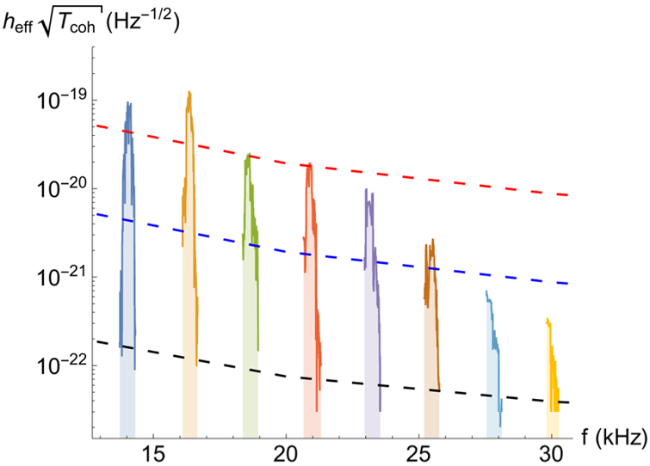
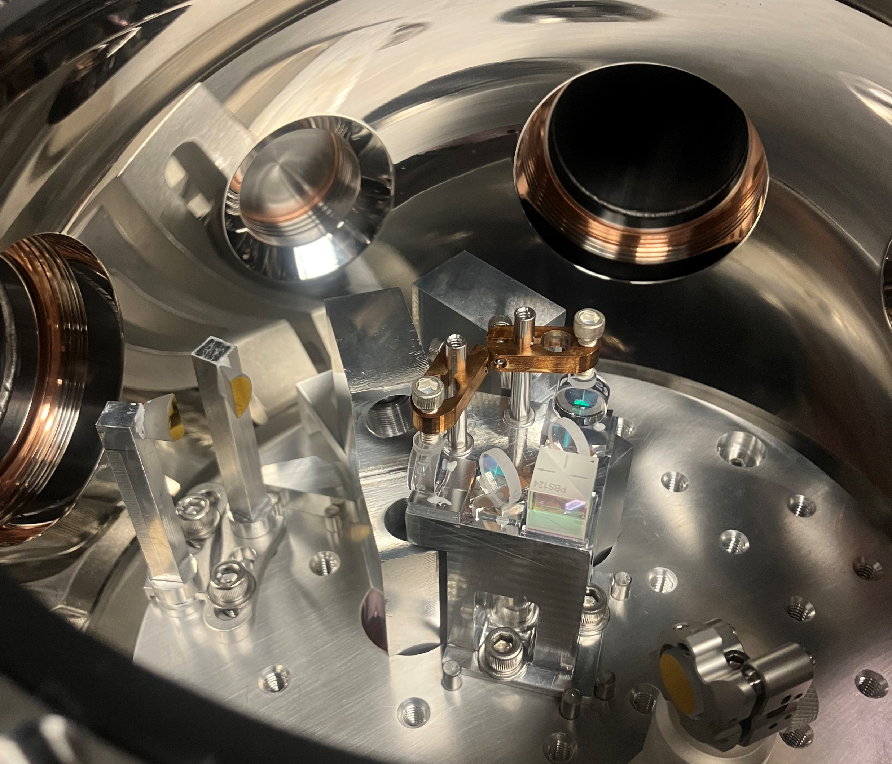
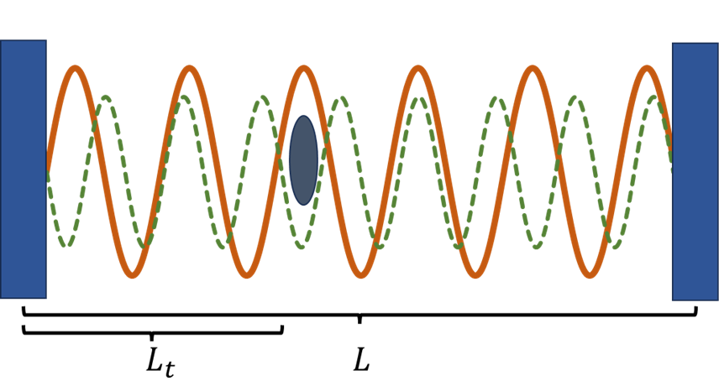
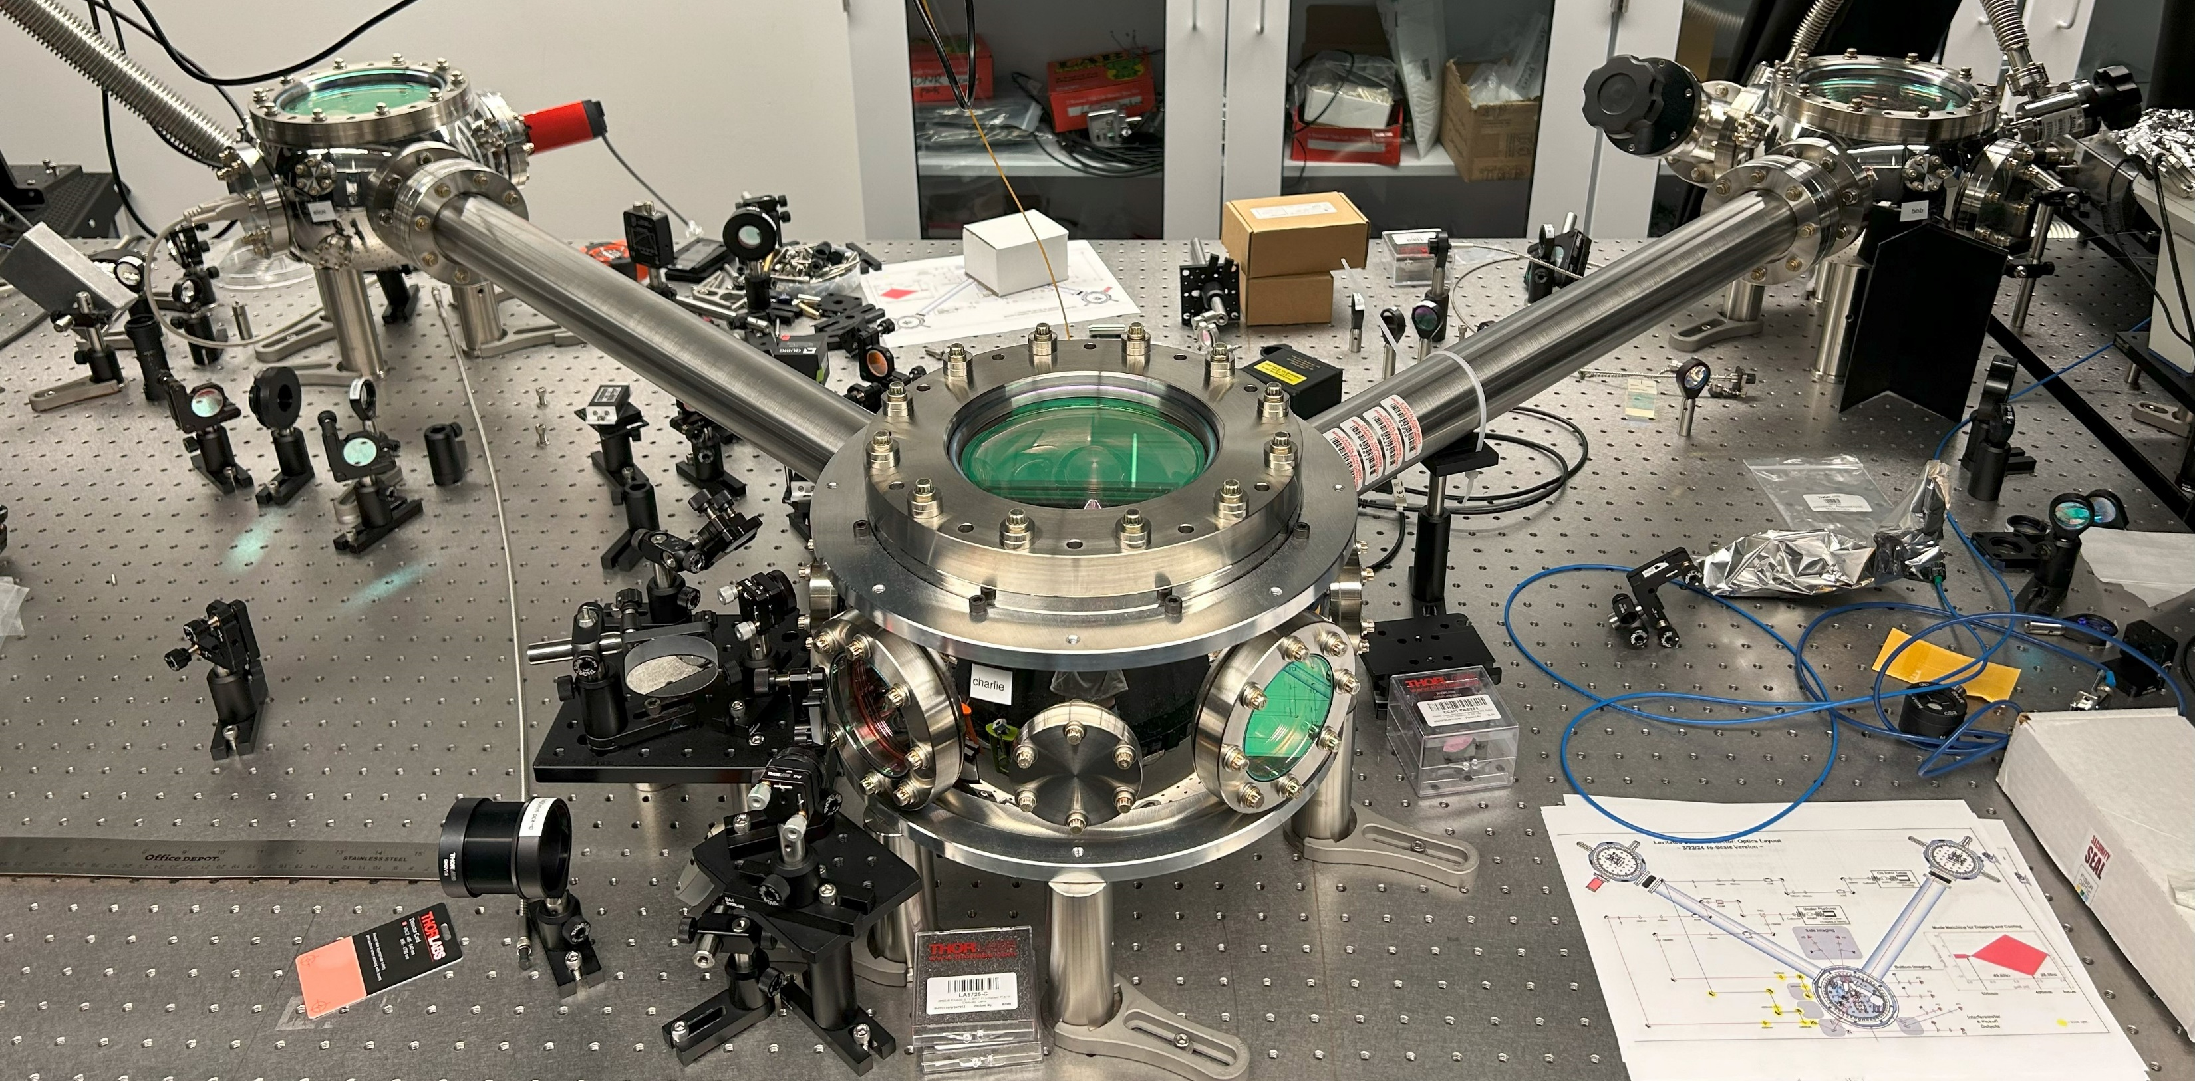
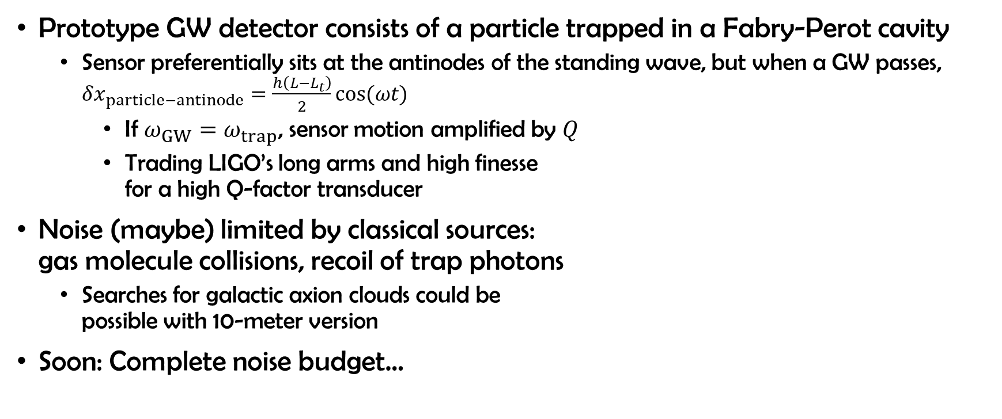
High Frequency GW Detection: A case for brand new technologies
Prototype GW detector consists of a particle trapped in a Fabry-Perot cavity
  Sensor preferentially sits at the antinodes of the standing wave, but when a GW passes, $δx_{particle−antinode}=\frac{h\left(L−L_{t}\right)}{2}cos(ωt)$
    If $ω_{GW}=ω_{trap}$, sensor motion amplified by $Q$
    Trading LIGO’s long arms and high finesse
    for a high Q-factor transducer
Noise (maybe) limited by classical sources:
gas molecule collisions, recoil of trap photons
  Searches for galactic axion clouds could be
  possible with 10-meter version
Soon: Complete noise budget…
With Nancy Aggarwal and the DMTELEVISION collaboration

Slide 10
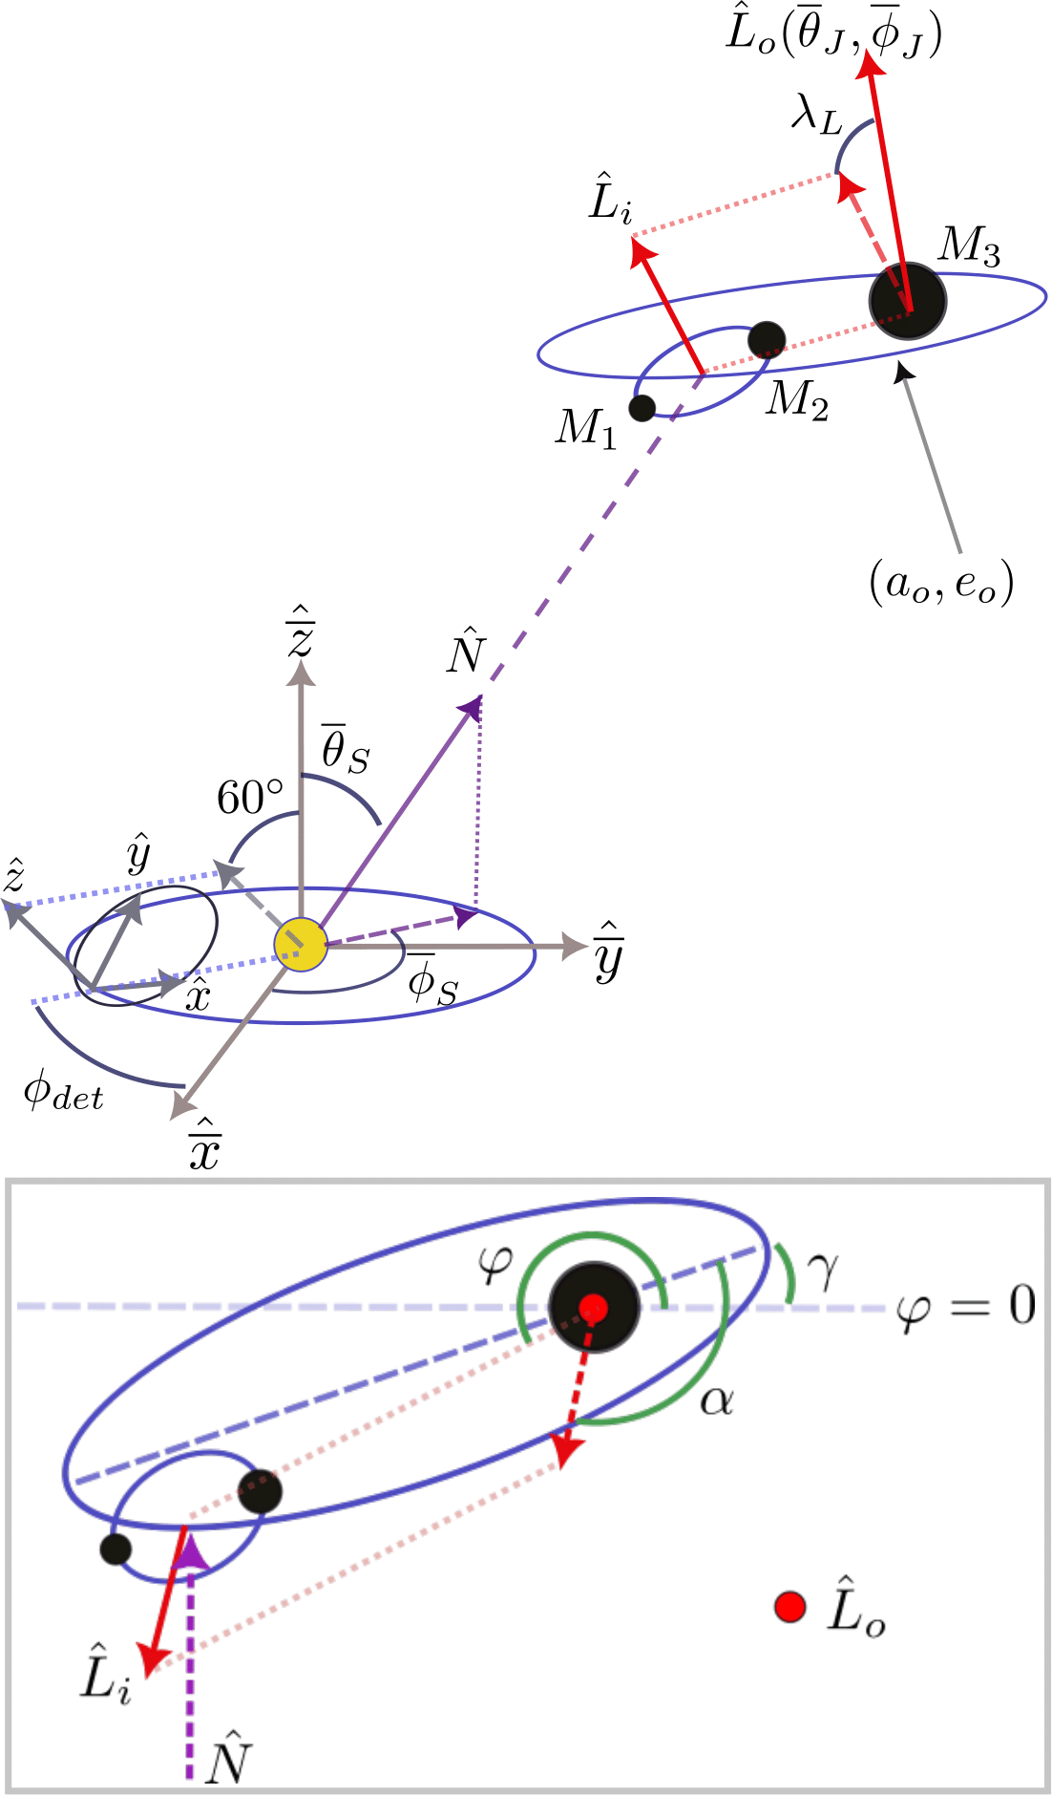
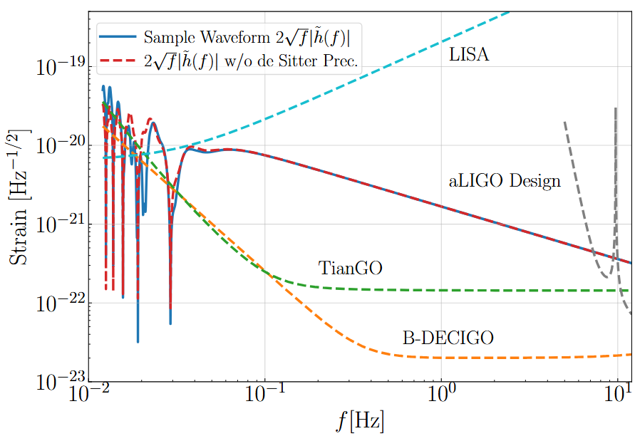
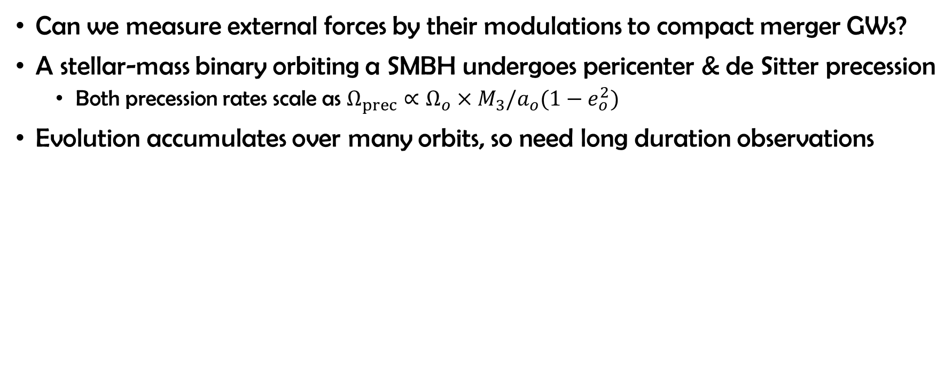
Low Frequency GW Astrophysics: Measuring circumbinary environments
Can we measure external forces by their modulations to compact merger GWs?
A stellar-mass binary orbiting a SMBH undergoes pericenter & de Sitter precession
  Both precession rates scale as $Ω_{prec}∝Ω_{o}×M_{3}/a_{o}(1−e_{o}^{2})$
Evolution accumulates over many orbits, so need long duration observations
With Brian Seymour and Hang Yu

Slide 11
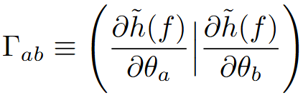
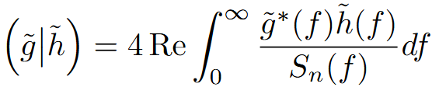





Low Frequency GW Astrophysics: Measuring circumbinary environments
Measurement uncertainty from Fisher Matrix:
SMBH properties can generally be well constrained!
$Ω_{o}={\left(\frac{M_{3}}{a_{o}}\right)}^{1/2}$ is very well measured from the frequency of the Doppler phase shift
  Relativistic precession breaks degeneracies in magnitude of $Φ_{D}$
Increasing $e_{o}$ improves precision, following precession rates
With Brian Seymour and Hang Yu

Slide 12



High Frequency GW Astrophysics: Tests of GR with Black Hole Ringdown
How does the environment around a compact merger impact tests of GR?
Perturbations to BHs solve a separable PDE w/ a wave equation in radial sector
Quasinormal modes accurately fit ringdown of a remnant BH
A small “bump” in the wave
equation potential can
destabilize the QNM spectrum
  Fortunately, time domain
  ringdown is stable
What if we incorporate a true
environmental perturbation?
Cheung et al., 2021.
LIGO Collaboration, 2016
With Colin Weller and Dongjun Li

Slide 13




High Frequency GW Astrophysics: Tests of GR with Black Hole Ringdown
Wave equation solution accounts for the stress-energy of the thin shell
Like a “bump”, the shell can either perturb frequencies or destabilize spectrum
  However, the polar (even parity) sector admits a QNM originating directly from the GW-driven motion of the shell!
The properties of the shell determine the
behavior of ringdown waveforms at late times
  Certain shell parameters can even produce an “echo”!
With Colin Weller and Dongjun Li

Slide 14



nHz
$μ$Hz
mHz
Hz
kHz
MHz
Adapting existing technology
New detector concepts
Probing galactic environments
Tests of General Relativity

Slide 15
End of Slides

Slide 16

Drawings

Slide 17















Drawings

